Slide 1
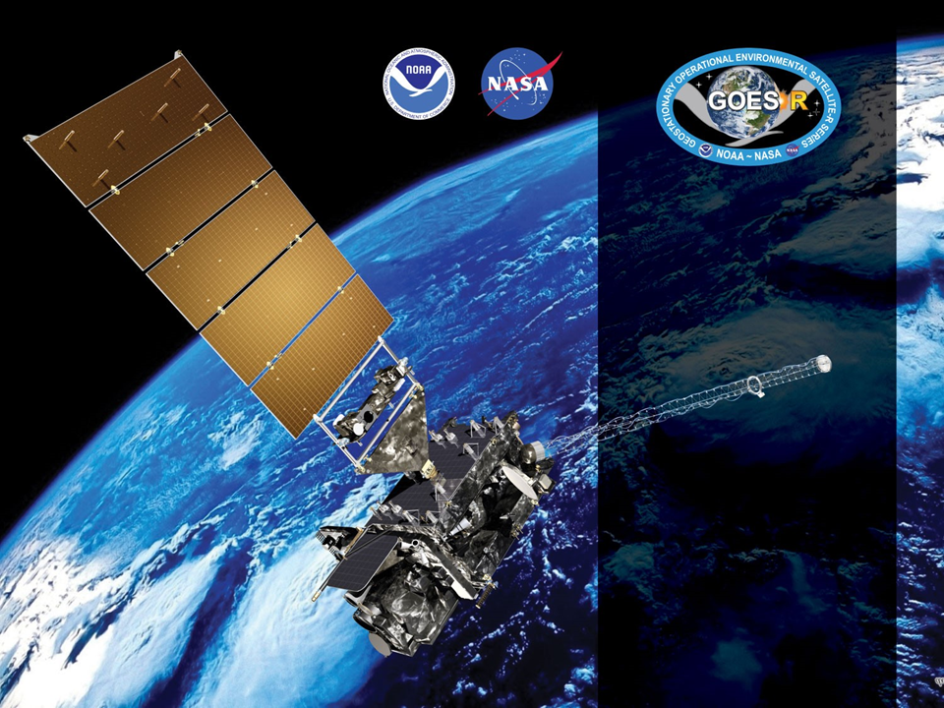
GOES-18 ABI L2+ SW Radiation Budget (SRB)
Provisional PS-PVR
November 9, 2022
GOES-R AWG
Istvan Laszlo¹, Hye-Yun Kim², Hongqing Liu², Rachel Pinker³, Kathy Lantz⁴ and the PRO Team
¹NOAA/NESDIS/STAR, ²IMSG, ³University of Maryland, ⁴NOAA/OAR/ESRL

Slide 2
Outline
Product Overview
Review of ADRs
Provisional Maturity Assessment
  Comparison with other satellite and reference data
  Impact of cloud phase on SRB products
Path to Full Validated Maturity
Summary and Recommendations
Supplement
  Various supporting material and notes

Slide 3
Product Overview: RSR
Reflected Shortwave Radiation: Top-Of-Atmosphere
  instantaneous SW (0.2-4.0 µm) flux emerging at the Earth’s TOA,
  produced on a global latitude/longitude grid at
    0.25 degree (25 km) resolution for Full Disk,
    0.25 degree (25 km) resolution for CONUS,
  produced once per hour.
  Spatial and temporal resolutions apply to Baseline product.
Table 5.25.1 in Product Definition and User’s Guide (PUG) Vol 5: Level 2+ Products, Revision 2.2 (12/17/2019)
 | Measurement |  |  |  | Mapping
Region | Range | Accuracy | Precision | Performance Conditions | Accuracy
Full Disk & CONUS | 0 to 1300 W/m² | 85 W/m² at high end of range (1000 W/m²) 65 W/m² at middle of range (350 W/m²) 110 W/m² at low end of range (<200 W/m²)^{[2]} | 100 W/m² for high end of range (1000 W/m²) 130 W/m² for middle of range (350 W/m²) 100 W/m² for low end of range (<200 W/m2^{)[2]} | LZA ≤ 70 degrees, daytime ^{[1]} | Full Disk: 4 km CONUS: 2 km
[1] Conditions for good quality prescribed by the algorithm are for SZA ≤ 70 degrees.
[2] NOTE: Low end specs are missing from PUG!

Slide 4
Product Overview: DSR
Downward Shortwave Radiation: Surface
  instantaneous SW (0.2-4.0 µm) flux received at the Earth’s surface,
  produced on a global latitude/longitude grid at
    0.50 degree (50 km) resolution for Full Disk,
    0.25 degree (25 km) resolution for CONUS,
    0.05 degree (05 km) resolution for Mesoscale,
  produced once per hour.
  Spatial and temporal resolutions apply to Baseline product.
Table 5.24.1 in Product Definition and User’s Guide (PUG) Vol 5: Level 2+ Products, Revision 2.2 (12/17/2019)
 | Measurement |  |  |  | Mapping
Region | Range | Accuracy | Precision | Performance Conditions | Accuracy
Full Disk, CONUS, & Mesoscale | 0 to 1500 W/m² | 85 W/m² at high end of range (1000 W/m²) 65 W/m² at middle of range (350 W/m²) 110 W/m² at low end of range (100 W/m²) | 100 W/m² for high end of range (1000 W/m²) 130 W/m² for middle of range (350 W/m²) 100 W/m² for low end of range (100 W/m²) | LZA ≤ 70 degrees, daytime, solar elevation angle > 25 degrees ^{[1]} | Full Disk: 4 km CONUS: 2 km Mesoscale: 1 km
[1] Conditions for good quality prescribed by the algorithm are for SZA ≤ 70 degrees.

Slide 5
GOES-R DSR/RSR Product
Precedence Chain
Cloud phase, optical depth, droplet size, top height
ABI
Climatology
4-level Cloud Mask
Cloud & Moisture Imagery
DSR
RSR
Snow Mask
ABI FSC product
GFS water equivalent snow depth
TPW
ABI product
GFS product
Climatology
Indirect Path Algorithm

Slide 6
Pre-Provisional Time-Line
01 Mar 2022 GOES-T Launch
11 May 2022 GOES-18 SRB is at Beta Maturity
16 May–15 Jul 2022 Spacecraft drift to West slot
25 Jul 2022 Band 2 calibration adjustment
27 Jul 2022 L1b data reached Provisional
28 Sept 2022 Clear-sky mask reached Provisional
  Cloud phase and cloud height products are not yet Provisional maturity
9 Nov 2022 GOES-18 SRB PS-PVR Provisional

Slide 7
ADRs IN PROGRESS PRIOR TO GOES-18 SRB PROVISIONAL REVIEW
GOES-18 Shortwave Radiation Budget L2 Product Provisional PS-PVR

Slide 8
ADRs in Progress
Title | Description (date submitted) | Impact | Mitigation | Status
ADR617 | ClearCompAlb is incorrect in MESO product. Time series has only a single value (2/28/18). | Incorrect ClearCompAlb value causes incorrect retrievals in indirect path. | N/A On hold until removing reprojection issue is decided | Not Installed
ADR864 | G17 MESO are located incorrectly (11/13/18). | Hinders validation. |  | Not Installed
ADR914 | MESO DSR is filled with _FillValue during local daytime (1/5/18). | Hinders validation. |  | Not Installed
ADR933 | DSRM2 is filled with _FillValue all day (4/8/19). | Hinders validation. |  | Not Installed
ADR1062 | MESO products are missing for almost half of a day (11/14/19) | Hinders validation. |  | Not Installed
ADR408/393 | At beta PSPVR, reprojection was reported to be detrimental to the usability of the product by the community by AWG lead and PSPVR chair supported the change (7/31/17) | Reprojection is detrimental to the usability of the product by the community. | Revisit on enterprise date | Not Installed
ADR743 | Missing flag_meanings attribute for PQI3 (4/16/18). | Hinders usage and getting information from it. | Revisit on enterprise date | Not installed
 | PQIs are not initialized with _FillValue (4/16/18). | One may assume that provided values are valid. | Revisit on enterprise date | Not installed
ADR994 | TPW source in PQI1 was set incorrectly for some mixed scene grids (8/5/19) | Hinders usage and getting information from it. | Revisit on enterprise date | Not installed
MESO DOMAIN ISSUE
Little Impact
Moderate Impact
Big Impact
ADRs inherited from G17 and still apply to G18.
Except for ADRs for MESO domain, ADRs have little impact on product quality.

Slide 9
Issues with no ADR
Title | Description | Impact | Mitigation and Schedule
Incorrect statistics in CONUS metadata | DSR and RSR statistics (mean, max, min, standard deviation) in metadata are likely incorrect in CONUS product. | Hinders usage and getting information from it. | Issue is now only present in M4 CONUS. Expected to be corrected in the Enterprise version.
Little Impact
Moderate Impact
Big Impact
Longstanding, known issue: Mean, max, min and standard deviation in Ground System M4 CONUS file cannot be reproduced from DSR data in file. No ADR was generated, issue is expected to be resolved with implementation of the enterprise algorithm.
  Example: M4 CONUS DSR statistics for 2022253_1500 UTC
Source | Min. (W m⁻²) | Max. (W m⁻²) | Mean (W m⁻²) | StdDev (W m⁻²)
Ground System | 6.7 | 918.49* | 381.63 | 160.1
AWG (All DQF) | 0.07 | 681.15 | 247.9 | 186.04
AWG (Good DQF) | 6.7 | 681.15 | 391.64 | 129.7
*Value not found in the DSR data.

Slide 10
Product Quality Evaluation
GOES-18 Shortwave Radiation Budget L2 Product Provisional PS-PVR

Slide 11
Provisional PLPTs
Test ID | Short description | 16 | 17 | 18/19
ABI-FD_DSR01 ABI-FD_RSR01 ABI-FD_PAR01^ | Verify that Mode 6 hourly FD products are within range | B | P | P
ABI-CONUS_DSR02 ABI-CONUS_RSR02 | Verify that Mode 6 hourly CONUS products are within range | B | P | P^
ABI-MESO_DSR03 | Verify that Mode 6 hourly mesoscale products are within range | B | P* | N/A^
ABI-FD_DSR04 ABI-FD_RSR04 | Verify that Mode 4 hourly FD products are within range | B | P | P
ABI-CONUS_DSR05 ABI-CONUS_RSR05 | Verify that Mode 4 hourly CONUS products are within range | B | P | P^
ABI-FD_DSR06 ABI-FD_RSR06 ABI-FD_PAR06^ | Assessment of FD accuracy and precision | B, P, F | P, F | P, F
ABI-CONUS_DSR07 ABI-CONUS_RSR07 | Assessment of CONUS accuracy and precision | B, P, F | P, F | P, F^
ABI-MESO_DSR08 | Assessment of mesoscale accuracy and precision | B, P, F | P* | N/A^
B, P, F indicate test is required for Beta, Provisional, Full maturity.
* Evaluation of MESO product was attempted but ultimately not possible to perform during GOES-17/18 Provisional testing due to an incorrect mapping issue.
^ Once the Enterprise version of the algorithm becomes operational, the PAR product will potentially be added, and the MESO and CONUS products will likely be decommissioned.
Reference: Geostationary Operational Environmental Satellite (GOES) – R Series ABI L2+ Surface Downward Shortwave Radiation and Top-of-Atmosphere Reflected Shortwave Radiation (DSR-RSR) Beta, Provisional and Full Validation Readiness, Implementation and Management Plan (RIMP) (v2.0; 410-R-RIMP-0327, Oct 6,2021).

Slide 12
Application of PLPT Analysis
Tests to Domains
Analysis Method |  | FD | CONUS | MESO
Visual | Inspection for range
 | Comparison with GOES-16 and GOES-17
Quantitative | Comparison with GOES-16 and GOES-17
 | Comparison of GOES-18 DSR with ground measurements (SURFRAD and SOLRAD)
 | Comparison of GOES-18 RSR with CERES RSR
Evaluation of MESO product was not possible due to incorrect mapping.
CERES: Clouds and the Earth Radiant Energy System
SURFRAD: Surface Radiation Budget Network (US)
SOLRAD: Solar radiation network (US)

Slide 13
GOES-18 Data Used in this Review
G18 DSR and RSR in CONUS, FD, and DSR in MESO.
Time period: 07/28 – 10/15, 2022; Days: 209 – 288
  G18 L1b reached Provisional maturity on 7/27/22
Matchups (set of quasi coincident and collocated G18 and reference data):
  RSR in CONUS and FD with CERES observations.
  DSR in CONUS and FD with SURFRAD and SOLRAD measurements.
    G18 data are spatially averaged within an area of 25-km radius centered on ground site.
    Reference data are temporally averaged within ±30-min centered on G18 retrieval time.
  No matchups for MESO DSR due to incorrect mapping (ADR 864).

Slide 14
Visual and Quantitative Comparisons:
Comparison with GOES-17
GOES-18 Shortwave Radiation Budget L2 Product Provisional PS-PVR

Slide 15
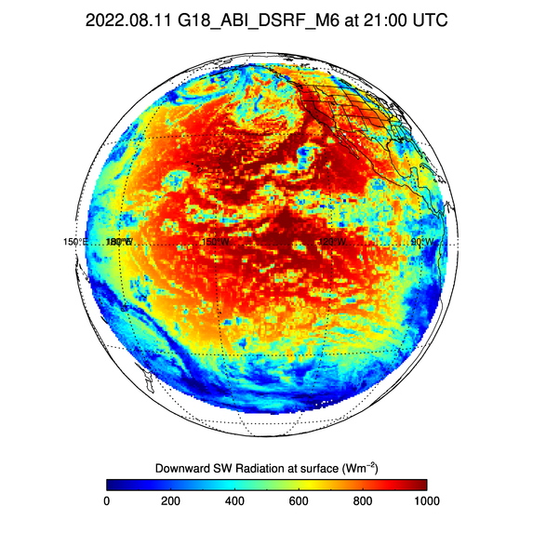
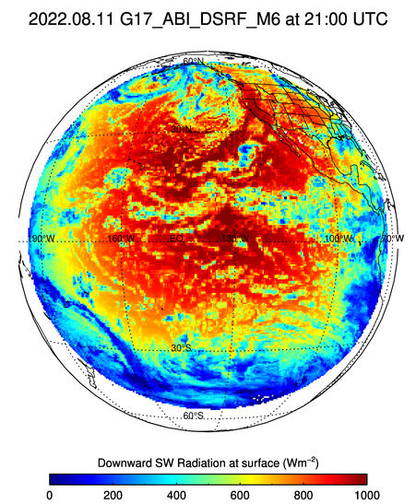
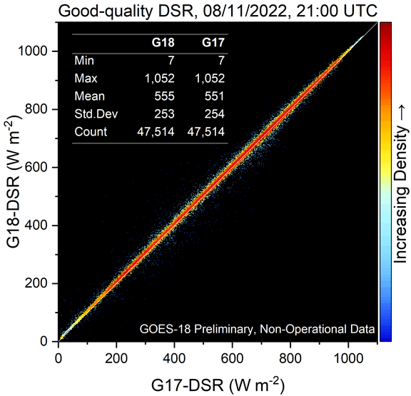
G18/G17 FD DSR Comparison 21 UTC on 8/11/22
PLPT test ABI-FD_DSR01
G18 and G17 Full Disk (FD) DSRs are visually similar.
G18 DSR is in expected range.
G18 and G17 statistics are very similar.

Slide 16
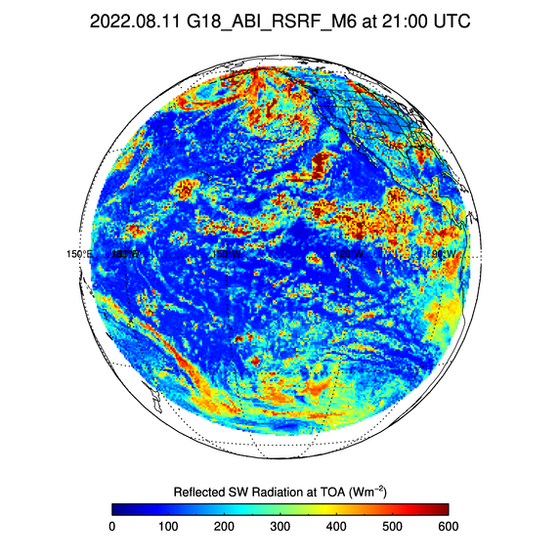
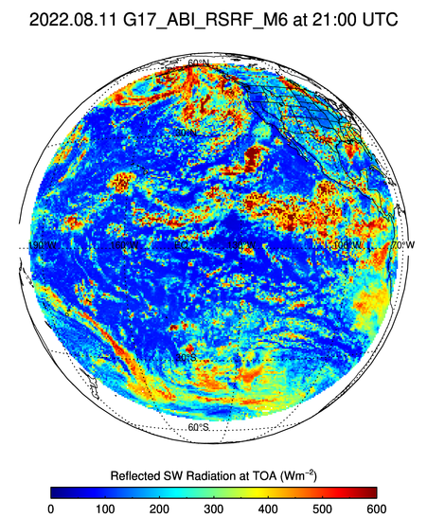
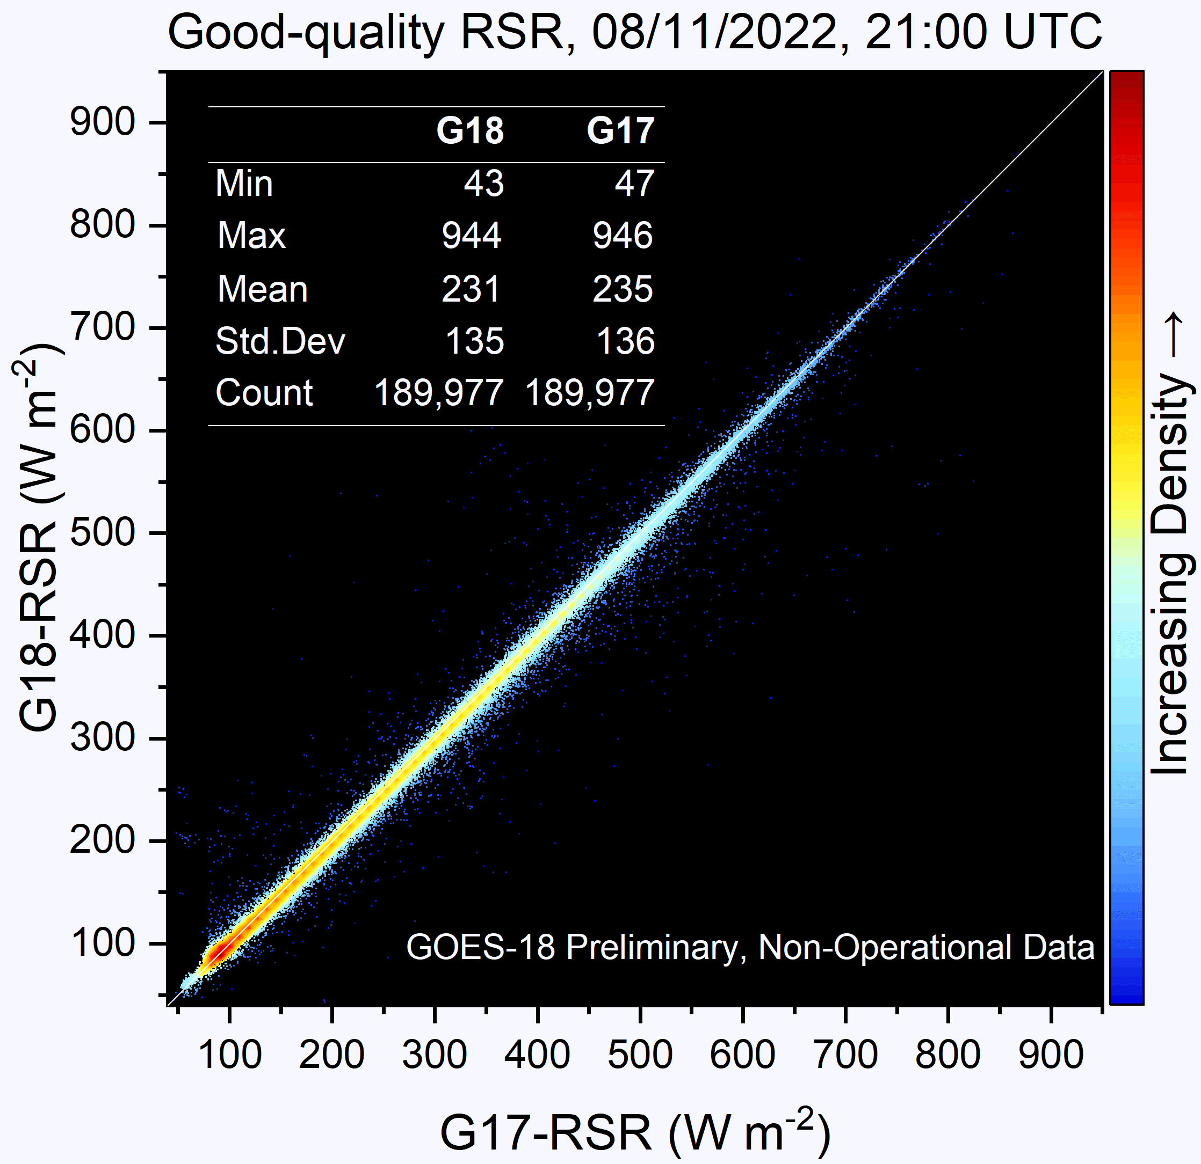
G18/G17 FD RSR Comparison 21 UTC on 8/11/22
PLPT test ABI-FD_RSR01
G18 and G17 Full Disk (FD) RSRs are visually similar.
G18 RSR is in expected range.
G18 and G17 statistics are very similar.

Slide 17
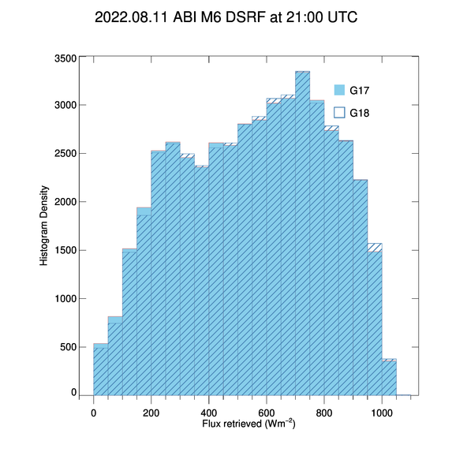
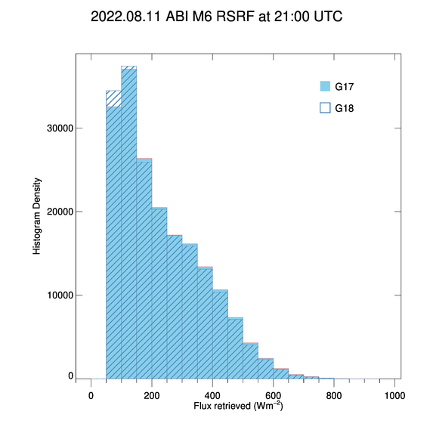
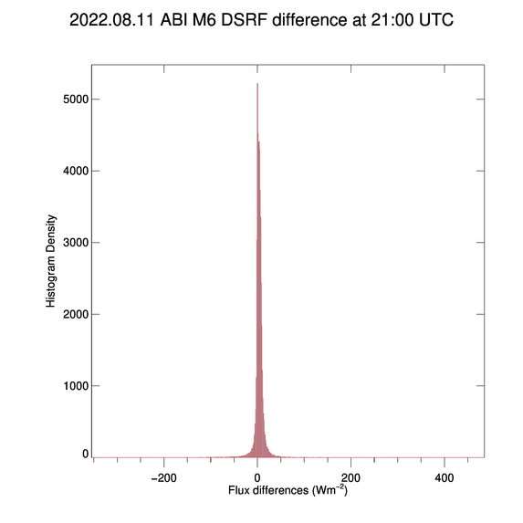
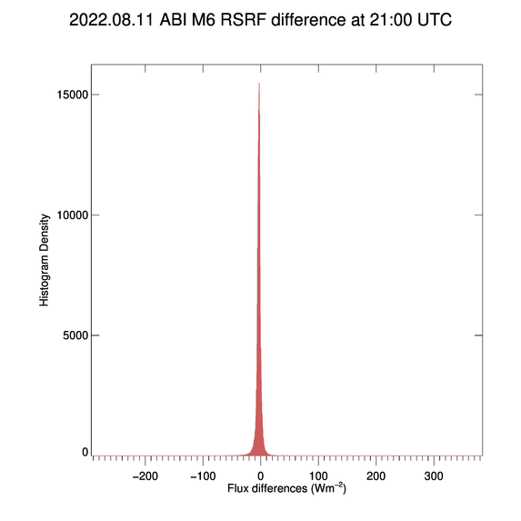
Flux difference at 21 UTC on 8/11/22
PLPT tests ABI-FD DSR01 and RSR01
Distributions of full-disk G18 DSR and RSR are similar to those from G17.
Largest number of G18 – G17 differences are clustered around the zero value.
The mean G18 - G17 DSR and RSR differences are +4 and -4 Wm⁻², respectively.

Slide 18
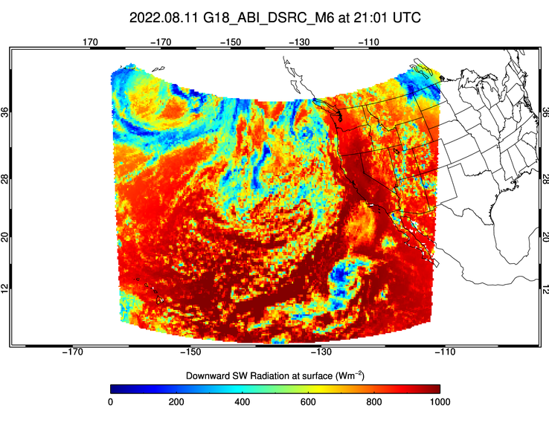

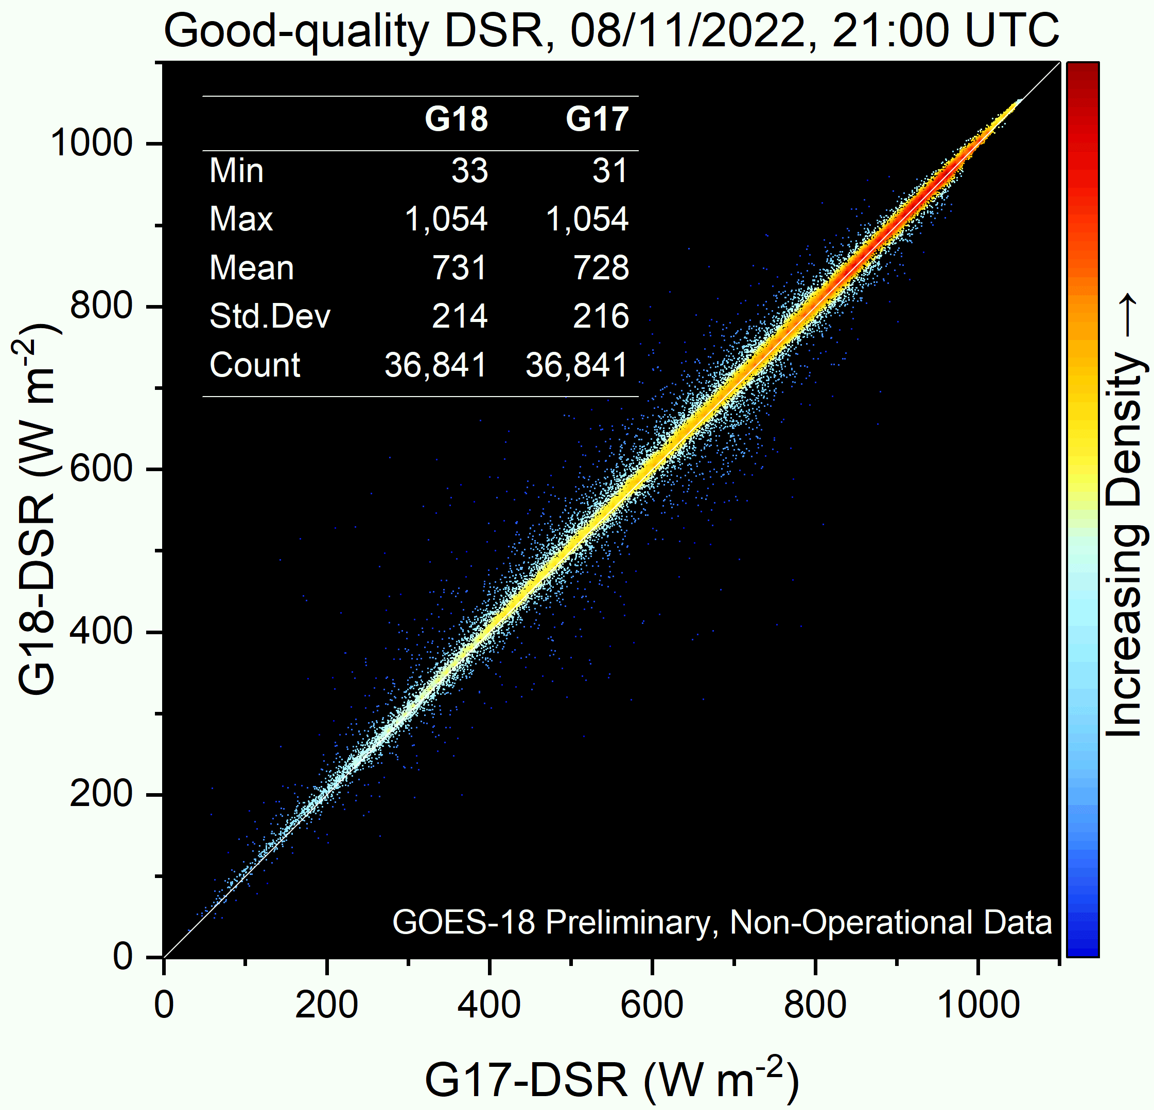
G18/G17 CONUS DSR Comparison: 21 UTC on 8/11/22
PLPT test ABI-CONUS_DSR02
G18 and G17 DSR fields are visually similar.
G18 DSR is in expected range.
G18 and G17 statistics are very similar.

Slide 19
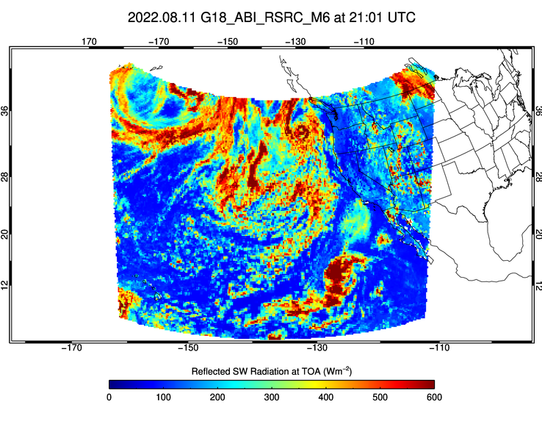
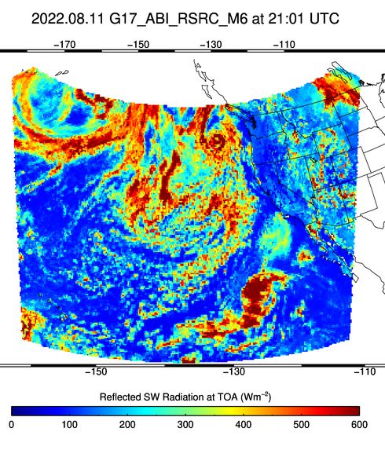
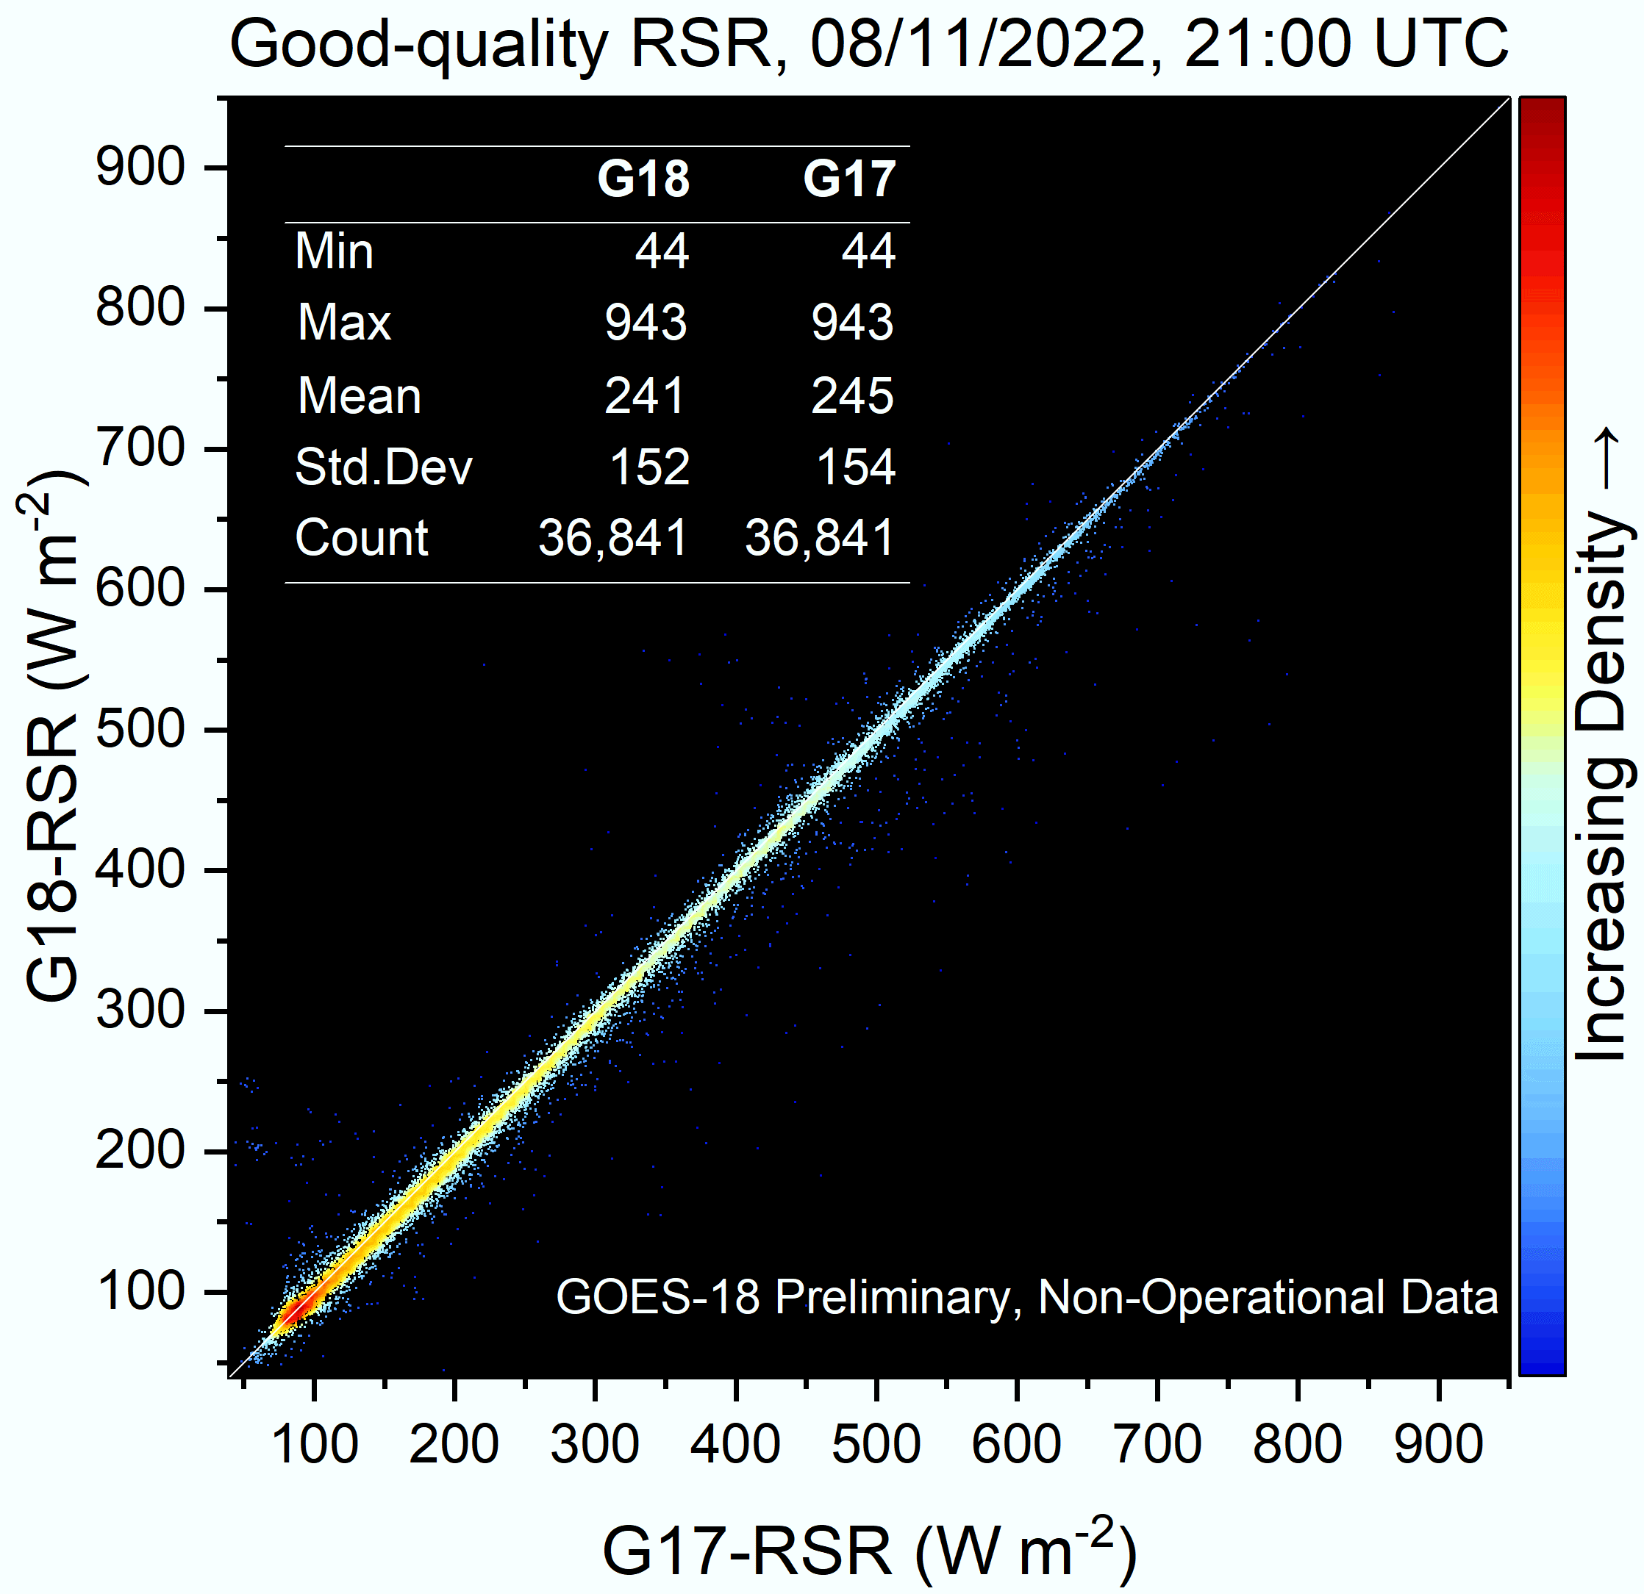
G18/G17 CONUS RSR Comparison: 21 UTC on 8/11/22
PLPT test ABI-CONUS_RSR02
G18 and G17 RSR fields are visually similar.
G18 RSR is in expected range.
G18 and G17 statistics are very similar.

Slide 20
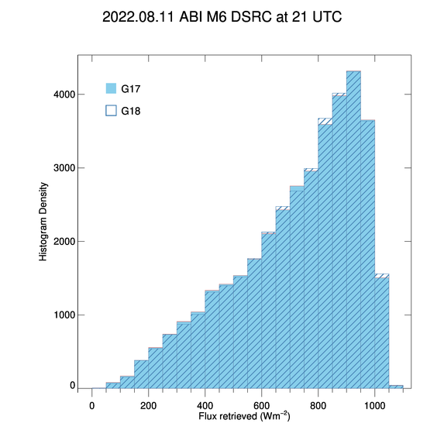
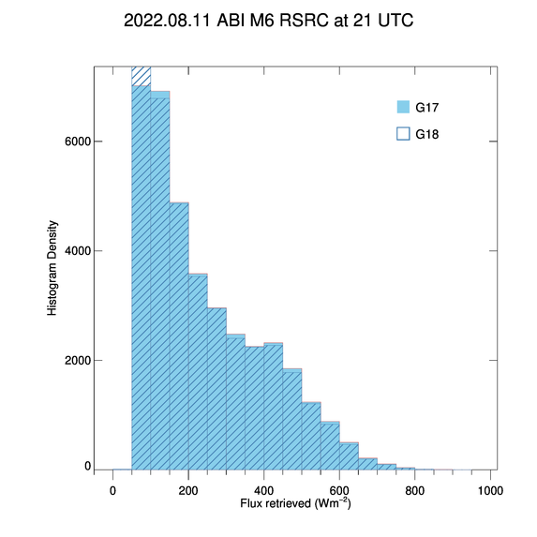
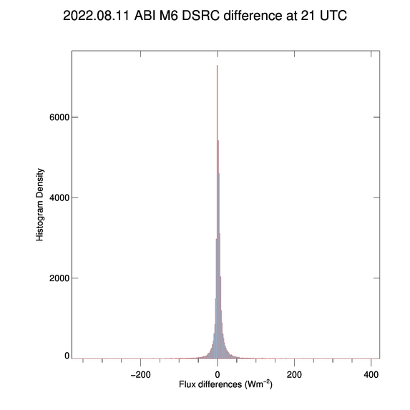
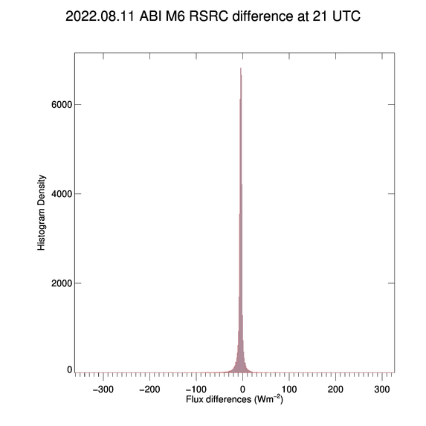
Flux difference at 21 UTC on 8/11/2022
PLPT tests ABI-CONUS DSR01 and RSR01
Distributions of CONUS G18 DSR and RSR are similar to those from G17.
Largest number of G18 – G17 differences are clustered around the zero value.
The mean G18 - G17 DSR and RSR differences are +3 and -4 Wm⁻², respectively.

Slide 21
Summary of PLPT tasks 01 and 02
Tasks ABI-FD_DSR01, ABI-FD_RSR01:
  G18 FD DSR and RSR are in expected range. (Passed)
  G18 and G17 FD DSRs and RSRs are visually similar.
  G18 and G17 FD DSR and RSR statistics (mean, min, max, std) are very similar.
Tasks ABI-CONUS_DSR02, ABI-CONUS_RSR02 :
  G18 CONUS DSR and RSR are in expected range. (Passed)
  G18 and G17 CONUS DSRs and RSRs are visually similar.
  G18 and G17 CONUS DSR and RSR statistics (mean, min, max, std) are very similar.

Slide 22
Summary of PLPT tasks 03-05
ABI-MESO_DSR03 (Supplement A):
  Meso DSR is in expected range (Passed)
  Evaluation with reference data was not possible due to incorrect mapping (Failed)
ABI-FD_RSR04, ABI-FD_DSR04, ABI-CONUS_RSR05, ABI-CONUS_DSR05 (Supplement B) :
  M4 FD and CONUS RSR and DSR are in expected ranges (Passed)
Comparison with G16 (Supplement C):
  G18 accuracy and precision are comparable to those of G16
Other findings (Supplement E):
  There is no detectable impact of the 7/25/2022 Band 2 calibration adjustment on the SRB products

Slide 23
Comparison with Reference data
GOES-18 Shortwave Radiation Budget L2 Product Provisional PS-PVR

Slide 24
Definitions of Metrics for Quantitative Comparisons
Passed: Accuracy and Precision meet or slightly exceed requirements. Potential contributors for deviations are identified.
Partial-Passed: Accuracy/Precision deviates significantly from requirements, but potential contributors for deviations are identified.
Failed: Accuracy/Precision deviates significantly from requirements and source of poor performance is unknown, or source known and correction requires new algorithm.

Slide 25
Comparison of GOES-18 RSR with CERES RSR
GOES-18 Shortwave Radiation Budget L2 Product Provisional PS-PVR

Slide 26
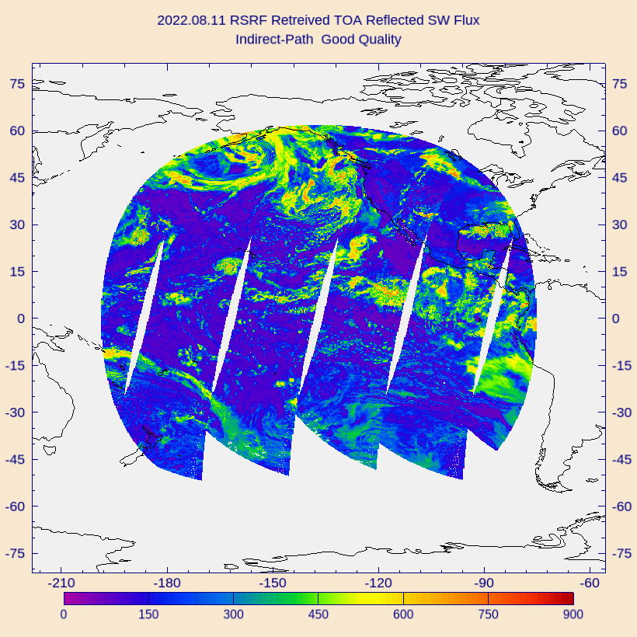
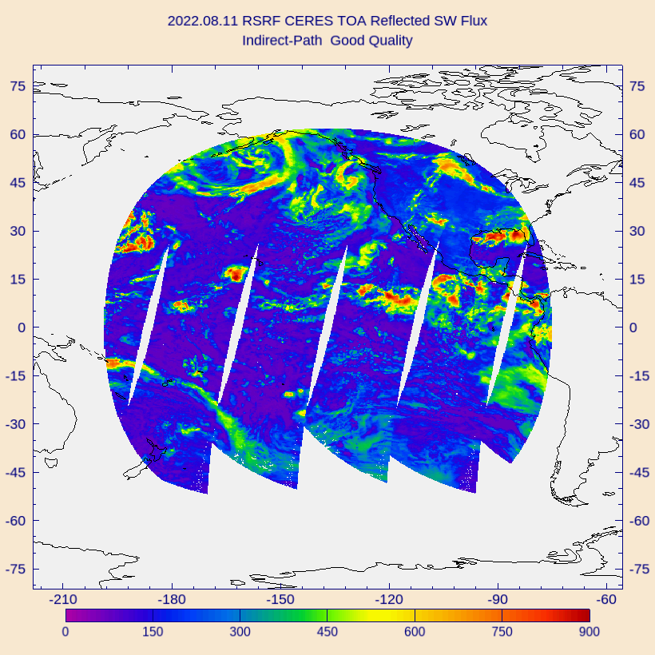
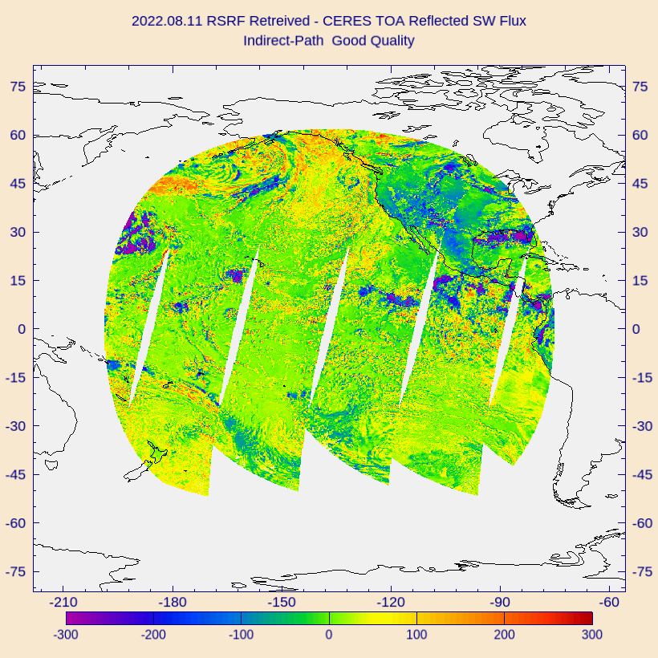
PLPT Task ABI-FD_RSR06
Comparison of G18 RSR with CERES/Terra TOA reflected flux on 8/11/2022 over full disk:
  G18 (left), CERES (middle), and G18 – CERES difference (right).
  Largest differences (± 300 Wm⁻²) are over clouds.

Slide 27
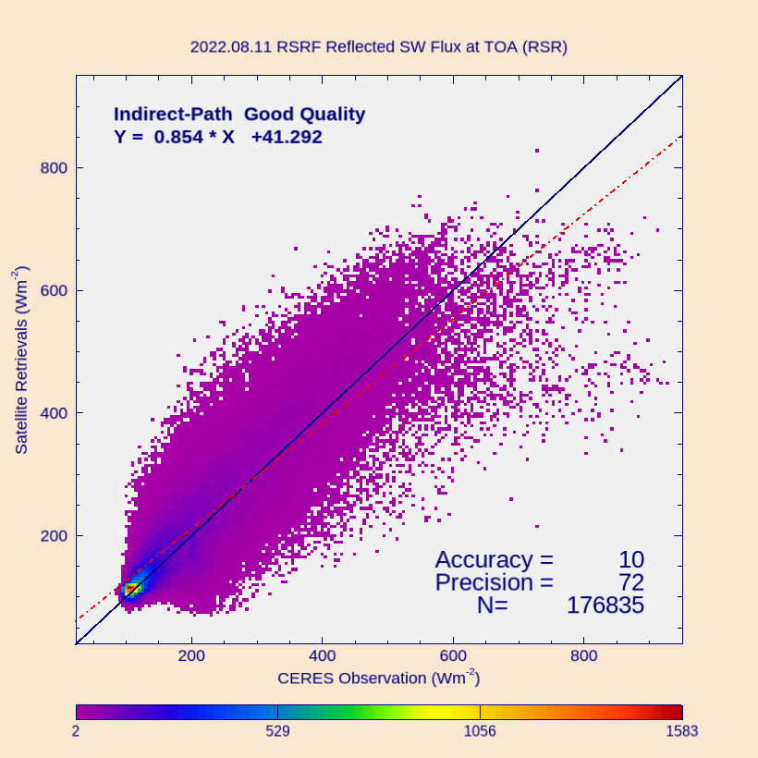
PLPT Task ABI-FD_RSR06
Comparison of G18 FD RSR product with CERES/Terra TOA fluxes for 8/11/2022 over full disk (over 176K points).
Range | A | P | N
CERES < 200 | 15 (110) | 43 (100) | 103,010
[200, 500] | 17 (65) | 80 (130) | 65,690
CERES > 500 | -117 (85) | 144 (100) | 8,135
Predominantly ice clouds
Requirements are in parenthesis. Units: W m⁻².
Only one day!
Accuracy (A) and precision (P) are within specs except for high range RSR (cloudy sky). (Similar to findings at the G17 Provisional PS-PVR.)
Accuracy (A): mean bias (satellite – reference)
Precision (P): standard deviation of biases
Number (N): number of samples

Slide 28
PLPT Task ABI-FD_RSR06
Comparison of G18 FD RSR product with CERES/Terra TOA fluxes for the time period 7/28 – 10/15, 2022 over full disk.
Accuracy (A) and precision (P) are within specs except for high range A and P (cloudy sky).
G18 AP stats are similar to G17 AP stats.
Empirical narrowband-to-broadband conversion (in enterprise algorithm) is expected to provide compliance (see Supplement D).
G18
Range | A | P | N
CERES < 200 | 40 (110) | 65 (100) | 16,230,138
[200, 500] | 24 (65) | 78 (130) | 13,087,788
CERES > 500 | -105 (85) | 136 (100) | 1,285,636
G17
Range | A | P | N
CERES < 200 | 47 (110) | 70 (100) | 16,930,224
[200, 500] | 33 (65) | 80 (130) | 13,578,343
CERES > 500 | -94 (85) | 137 (100) | 1,325,618
Requirements are in parenthesis. Units: W m⁻².
Accuracy (A): mean bias (satellite – reference)
Precision (P): standard deviation of biases
Number (N): number of samples

Slide 29
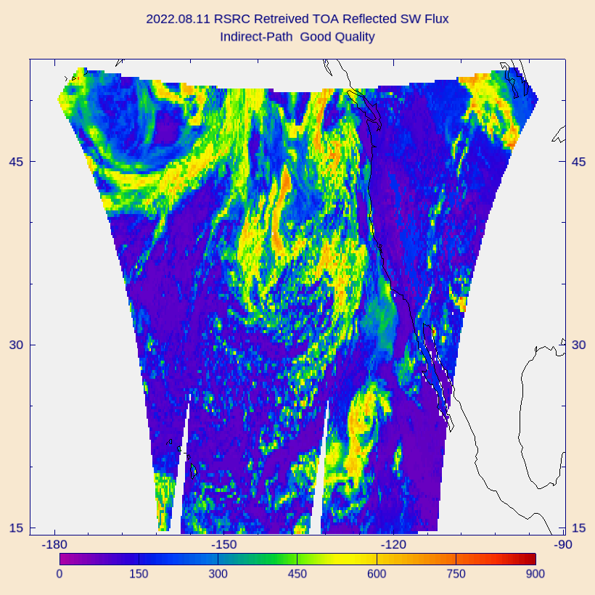
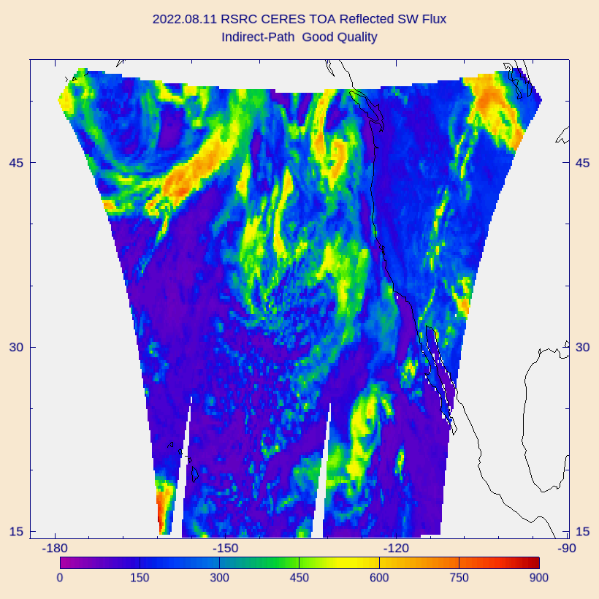
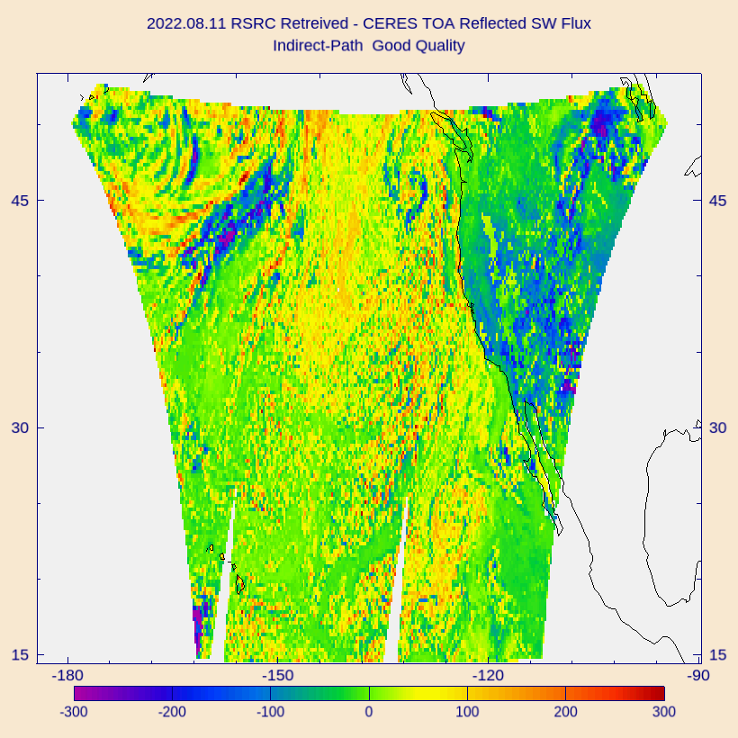
PLPT Task ABI-CONUS_RSR07
Comparison of G18 RSR with CERES/Terra TOA reflected flux on 8/11/2022 over CONUS:
  G18 (left), CERES (middle), and G18 – CERES difference (right).
  Largest differences (± 300 Wm⁻²) are over clouds.

Slide 30
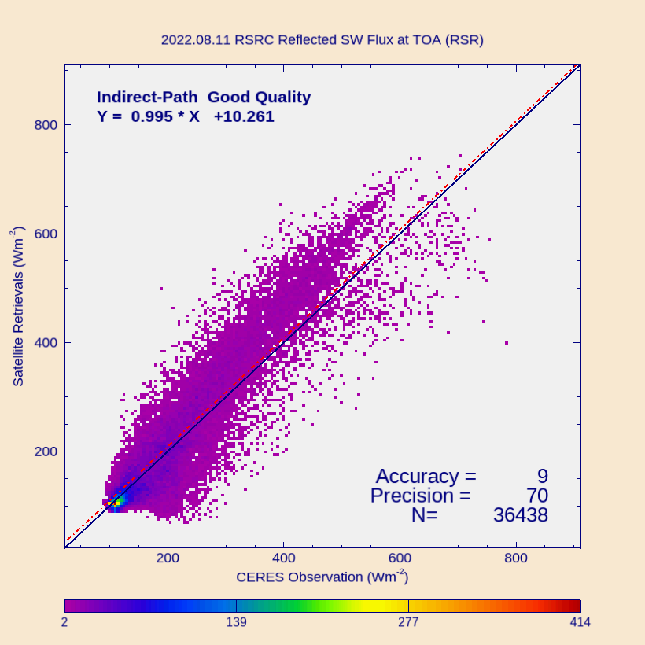
PLPT Task ABI-CONUS_RSR07
Comparison of G18 RSR product with CERES/Terra TOA fluxes for 8/11/2022 over CONUS (over 36K points).
Range | A | P | N
CERES < 200 | 1 (110) | 44 (100) | 18,915
[200, 500] | 27 (65) | 82 (130) | 15,450
CERES > 500 | -51 (85) | 115 (100) | 2,073
Requirements are in parenthesis. Units: W m⁻².
Only one day!
Accuracy (A) and precision (P) are within specs except for high range RSR (cloudy sky). (Similar to findings at the G17 Provisional PS-PVR.)
Accuracy (A): mean bias (satellite – reference)
Precision (P): standard deviation of biases
Number (N): number of samples

Slide 31
PLPT Task ABI-CONUS_RSR07
Comparison of G18 RSR product with CERES/Terra TOA fluxes for the time period 7/28 – 10/15, 2022 over CONUS.
Accuracy (A) and precision (P) are within specs except for high range P (cloudy sky).
G18 AP stats are similar to G17 AP stats.
Empirical narrowband-to-broadband conversion (in enterprise algorithm) is expected to provide compliance (see Supplement D).
G18
Range | A | P | N
CERES < 200 | 5 (110) | 48 (100) | 1,426,999
[200, 500] | 30 (65) | 82 (130) | 1,097,762
CERES > 500 | -35 (85) | 103 (100) | 131,206
G17
Range | A | P | N
CERES < 200 | 9 (110) | 49 (100) | 1,528,097
[200, 500] | 37 (65) | 83 (130) | 1,176,927
CERES > 500 | -31 (85) | 105 (100) | 141,537
Requirements are in parenthesis. Units: W m⁻².
Accuracy (A): mean bias (satellite – reference)
Precision (P): standard deviation of biases
Number (N): number of samples

Slide 32
Comparison of GOES-18 DSR with SURFRAD and SOLRAD DSR
GOES-18 Shortwave Radiation Budget L2 Product Provisional PS-PVR

Slide 33
Reference Data for
Quantitative Evaluation of DSR
Surface Radiation Network (SURFRAD)
  Accurate, long-term, continuous measurements.
  7 permanent sites in climatologically diverse regions in the US.
Integrated Surface Irradiance Study (SOLRAD)
  Monitors surface radiation in the US, in collaboration with SURFRAD.
  Currently 7 stations are available.
Number of stations used depends on the domain
  CONUS: 8 stations,
  FD: 12 stations,
  2 stations (Penn State and Sterling) are not seen by GOES-18.

Slide 34
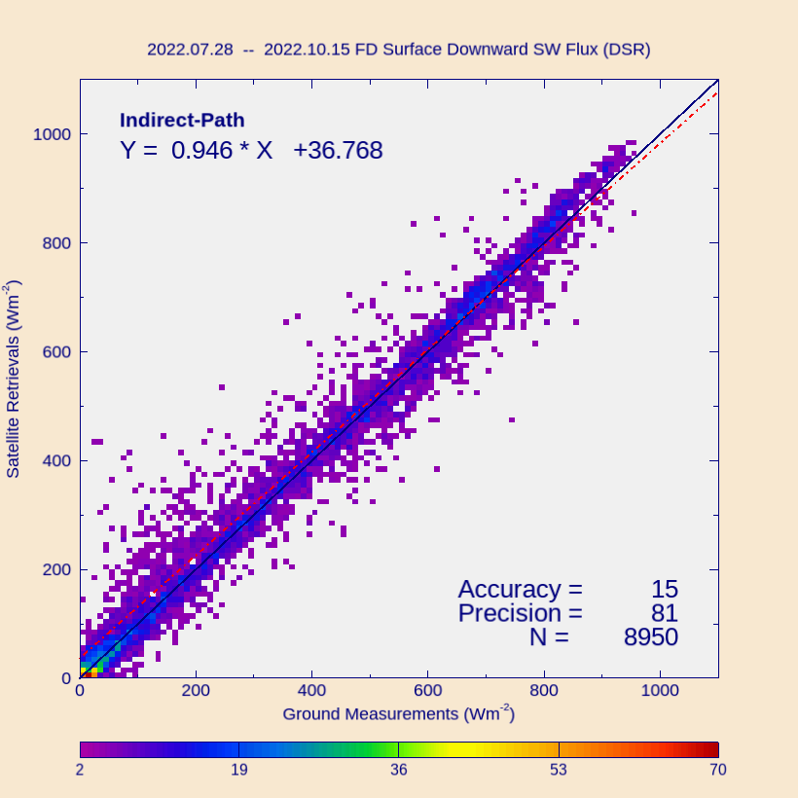
PLPT Task ABI-FD_DSR07
Comparison of FD DSR product (50 km) with SURFRAD and SOLRAD for 7/28 – 10/15, 2022.
Range | A | P | N
Ground < 200 | 32 (110) | 84 (100) | 2,759
[200, 500] | 19 (65) | 83 (130) | 2,716
Ground > 500 | -2 (85) | 73 (100) | 3,475
Requirements are in parenthesis. Units: W m⁻².
Accuracy (A) and Precision (P) requirements are met in all ranges.
Accuracy (A): mean bias (satellite – reference)
Precision (P): standard deviation of biases
Number (N): number of samples

Slide 35
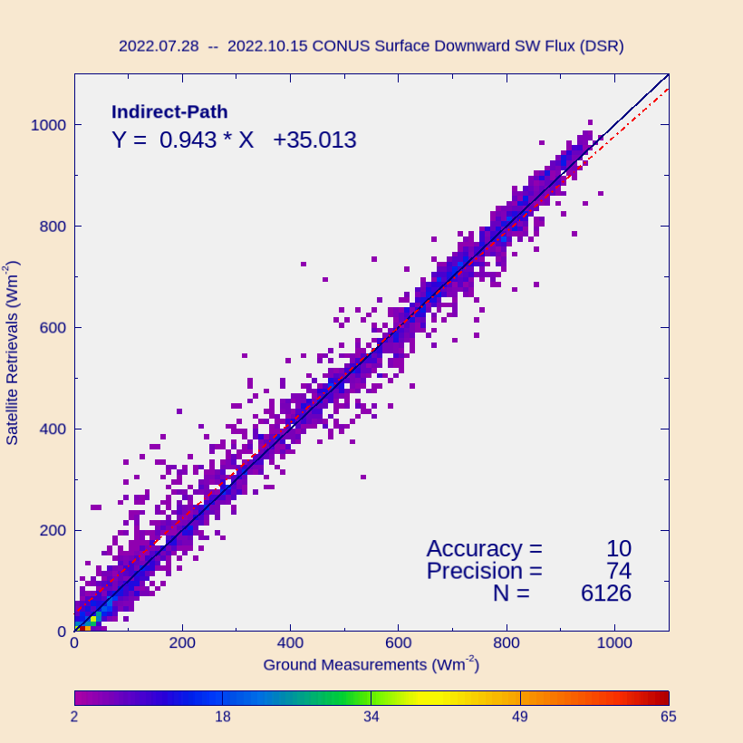
PLPT Task ABI-CONUS_DSR07
Comparison of CONUS DSR product (25 km) with SURFRAD and SOLRAD for 7/28 – 10/15, 2022.
Range | A | P | N
Ground < 200 | 29 (110) | 79 (100) | 1,780
[200, 500] | 21 (65) | 75 (130) | 1,740
Ground > 500 | -9 (85) | 64 (100) | 2,606
Requirements are in parenthesis. Units: W m⁻².
Accuracy (A) and Precision (P) requirements are met in all ranges.
Accuracy (A): mean bias (satellite – reference)
Precision (P): standard deviation of biases
Number (N): number of samples

Slide 36
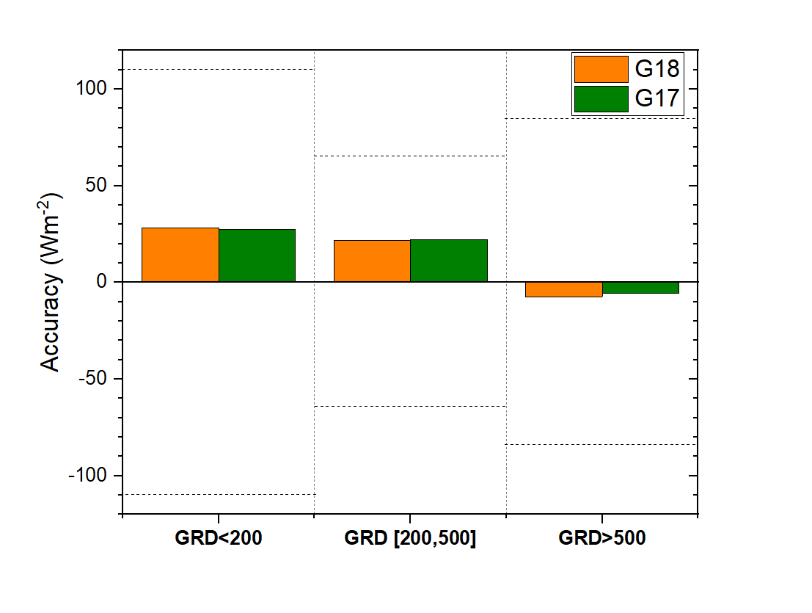
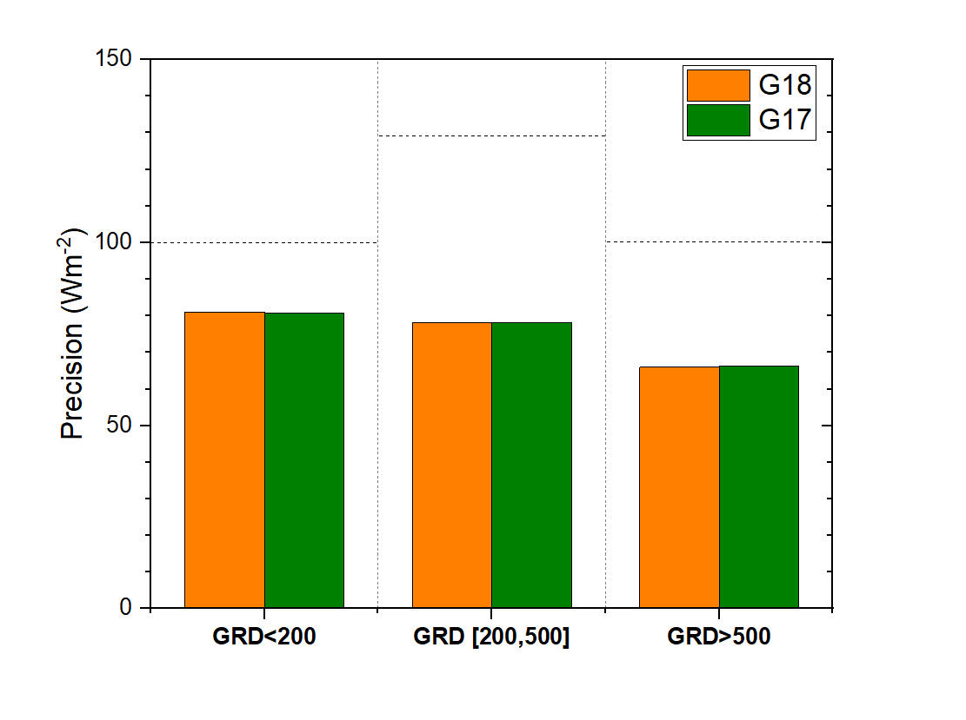
G18 and G17 DSR comparison over the same ground stations
DSRC from G18 and G17 for 7/28 – 9/30, 2022 compared with ground measurements.
  G18 A and P are comparable to G17 A and P.
Dotted lines represent requirements.

Slide 37
Summary of G18 vs. Reference RSR and DSR Comparison
G18 RSR is evaluated with CERES RSR (Passed).
  FD: within specs except for high range A and P (cloudy sky).
  CONUS: within specs except for high range P (cloudy sky).
  Quality of G18 RSR is very similar to quality of G17/G16 RSR.
G18 DSR is evaluated with SURFRAD and SOLRAD ground data (Passed).
  FD: within specs in ~ 3-month data.
  CONUS: within specs in ~ 3-month data.
  Quality of G18 DSR is very similar to quality of G17/G16 DSR.
MESO: G18 MESO DSR is incorrectly mapped (Failed).
  Longstanding, known issue.
  MESO products is expected to be decommissioned once the Enterprise version becomes operational.

Slide 38
Impact of cloud phase
GOES-18 Shortwave Radiation Budget L2 Product Provisional PS-PVR

Slide 39
Method of analysis
Cloud phase determines the conversion of narrowband ABI reflectances to broadband TOA albedos, from which then RSR and DSR are retrieved in the Indirect Path algorithm.
Analyzed the impact of potential cloud phase (water vs ice cloud) differences on the G18 and G17 products.
SRB products have low spatial resolution -> most grid cells include mixed (clear, water and/or ice cloud) scenes.
  Used CONUS data (25 km) to increase the chance of finding single-scene cells. Data from 21 UTC on 8/10/2022
  Extracted data for cells with scene types of
    G18: ice cloud, G17: water cloud;
    G18: water cloud, G17: ice cloud;
    both G18 and G17: water cloud;
    both G18 and G17: ice cloud.
  Calculated G18-G17 DSR and RSR differences

Slide 40
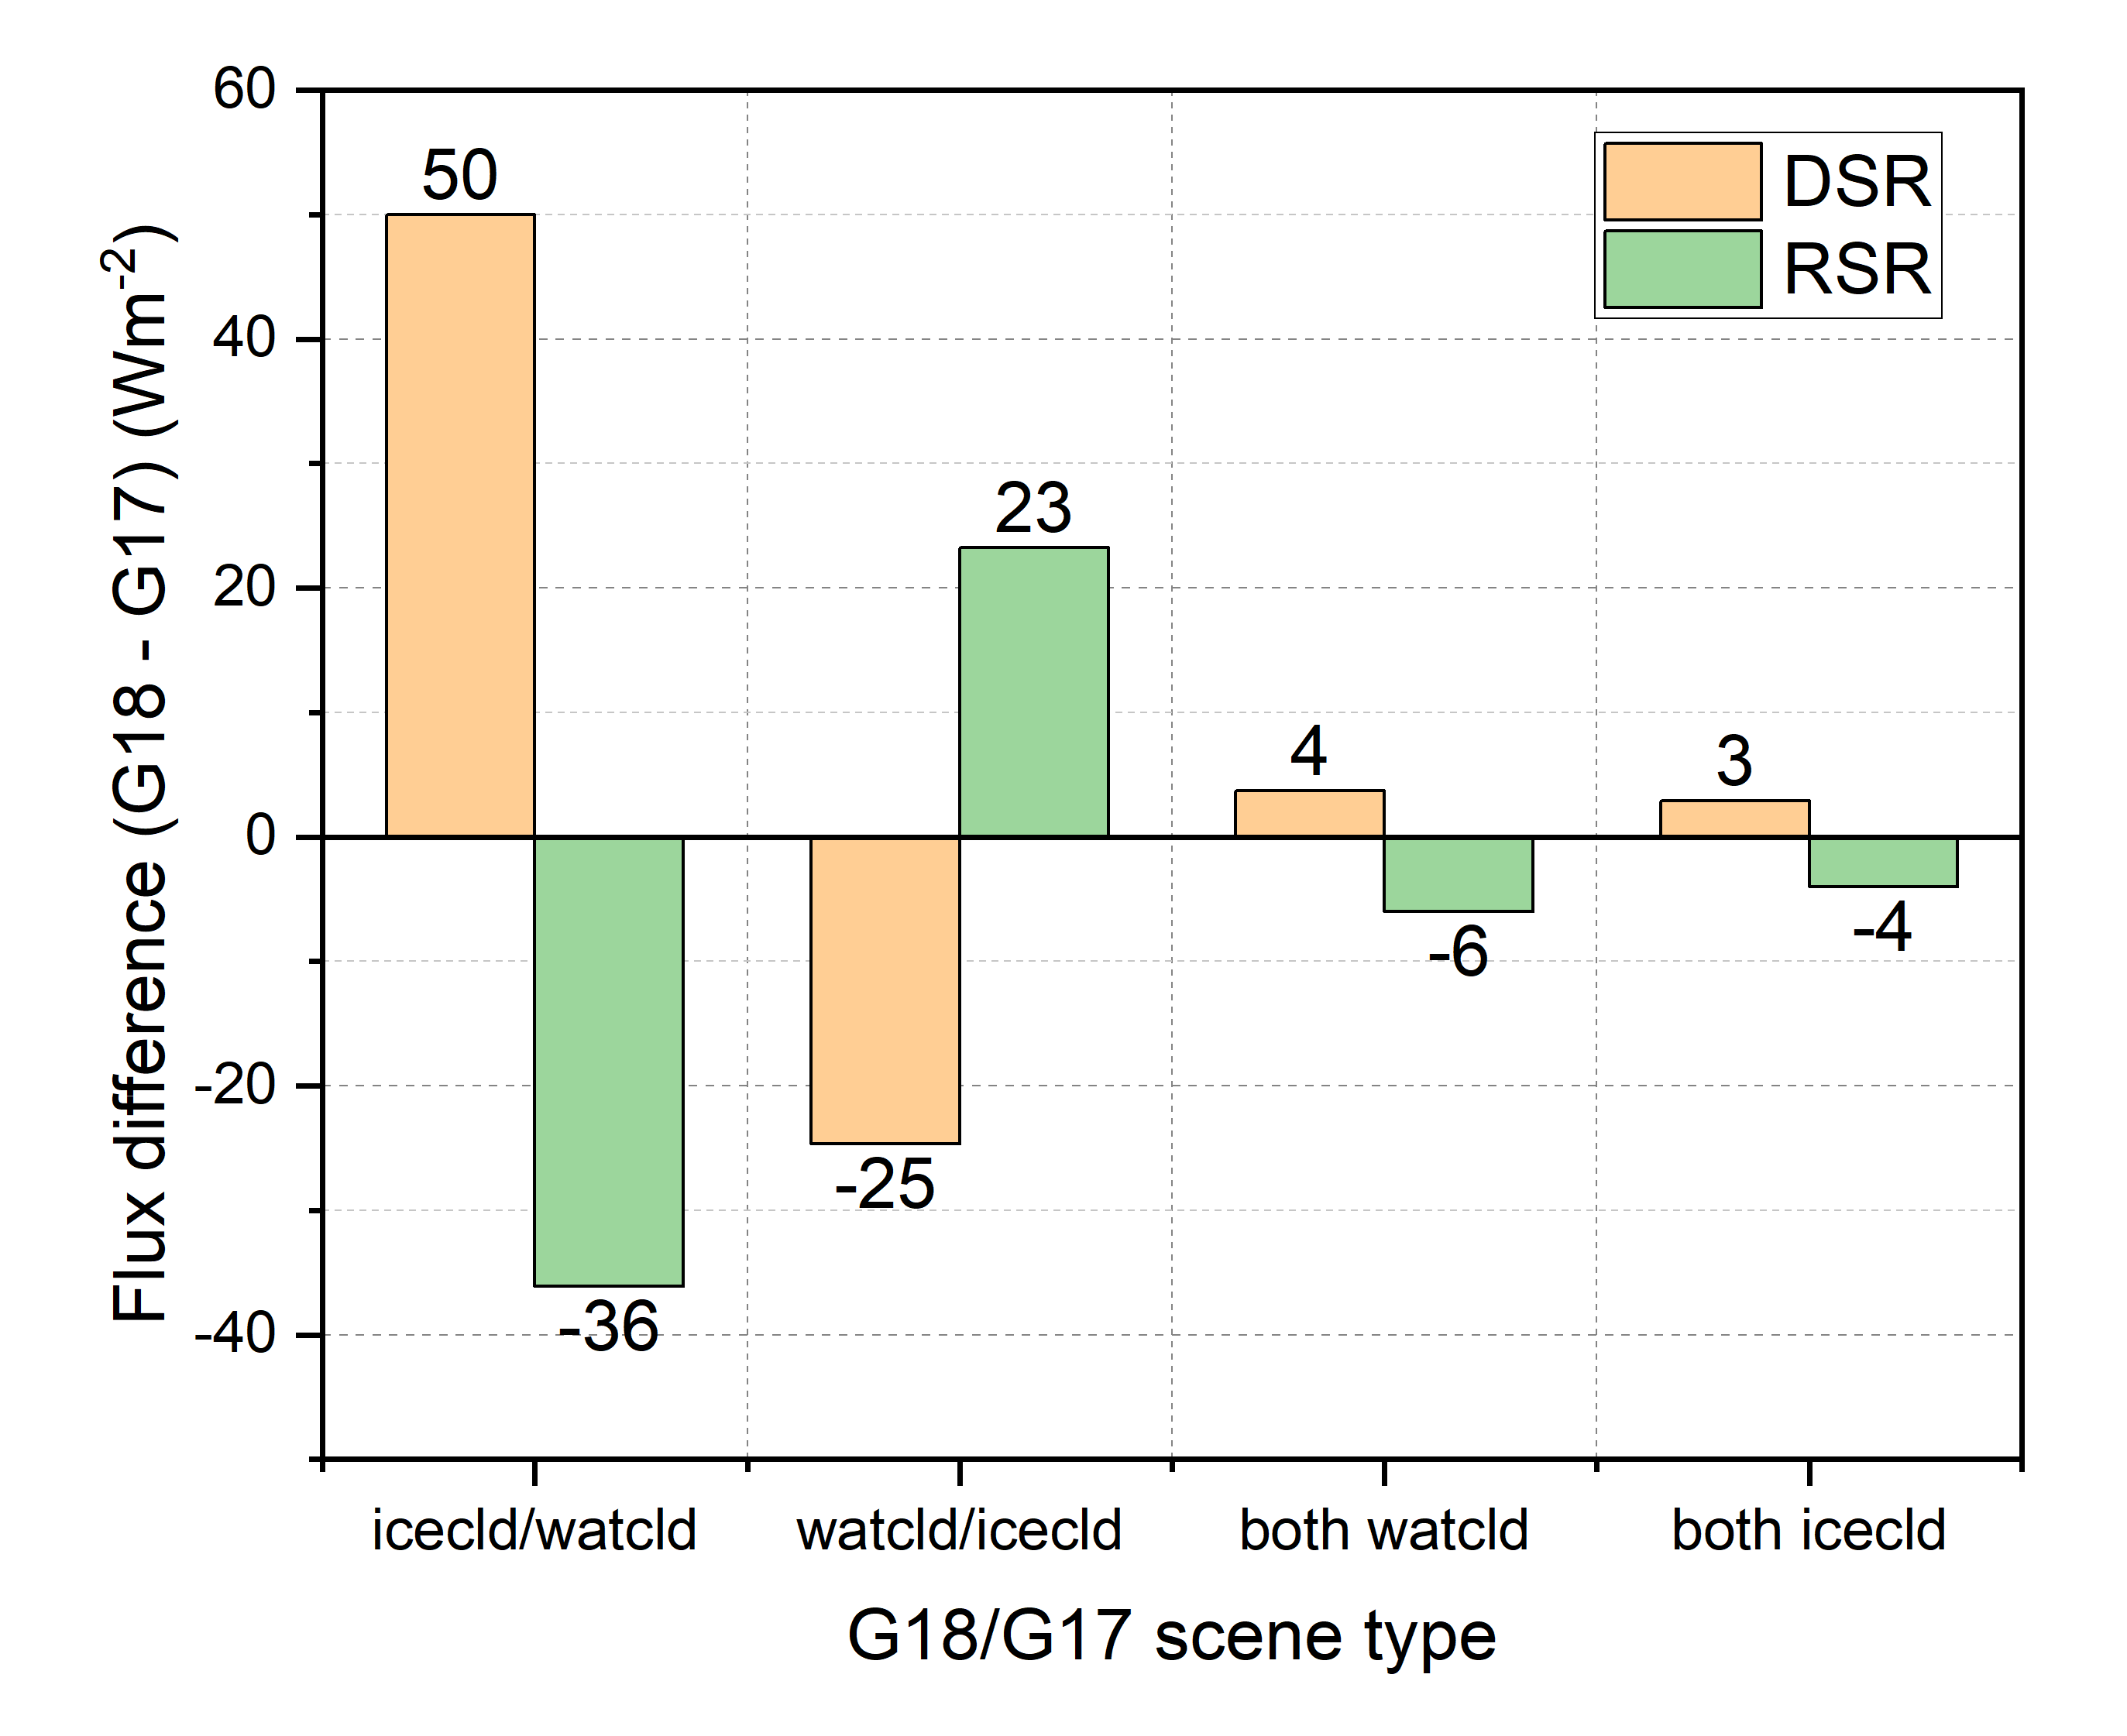
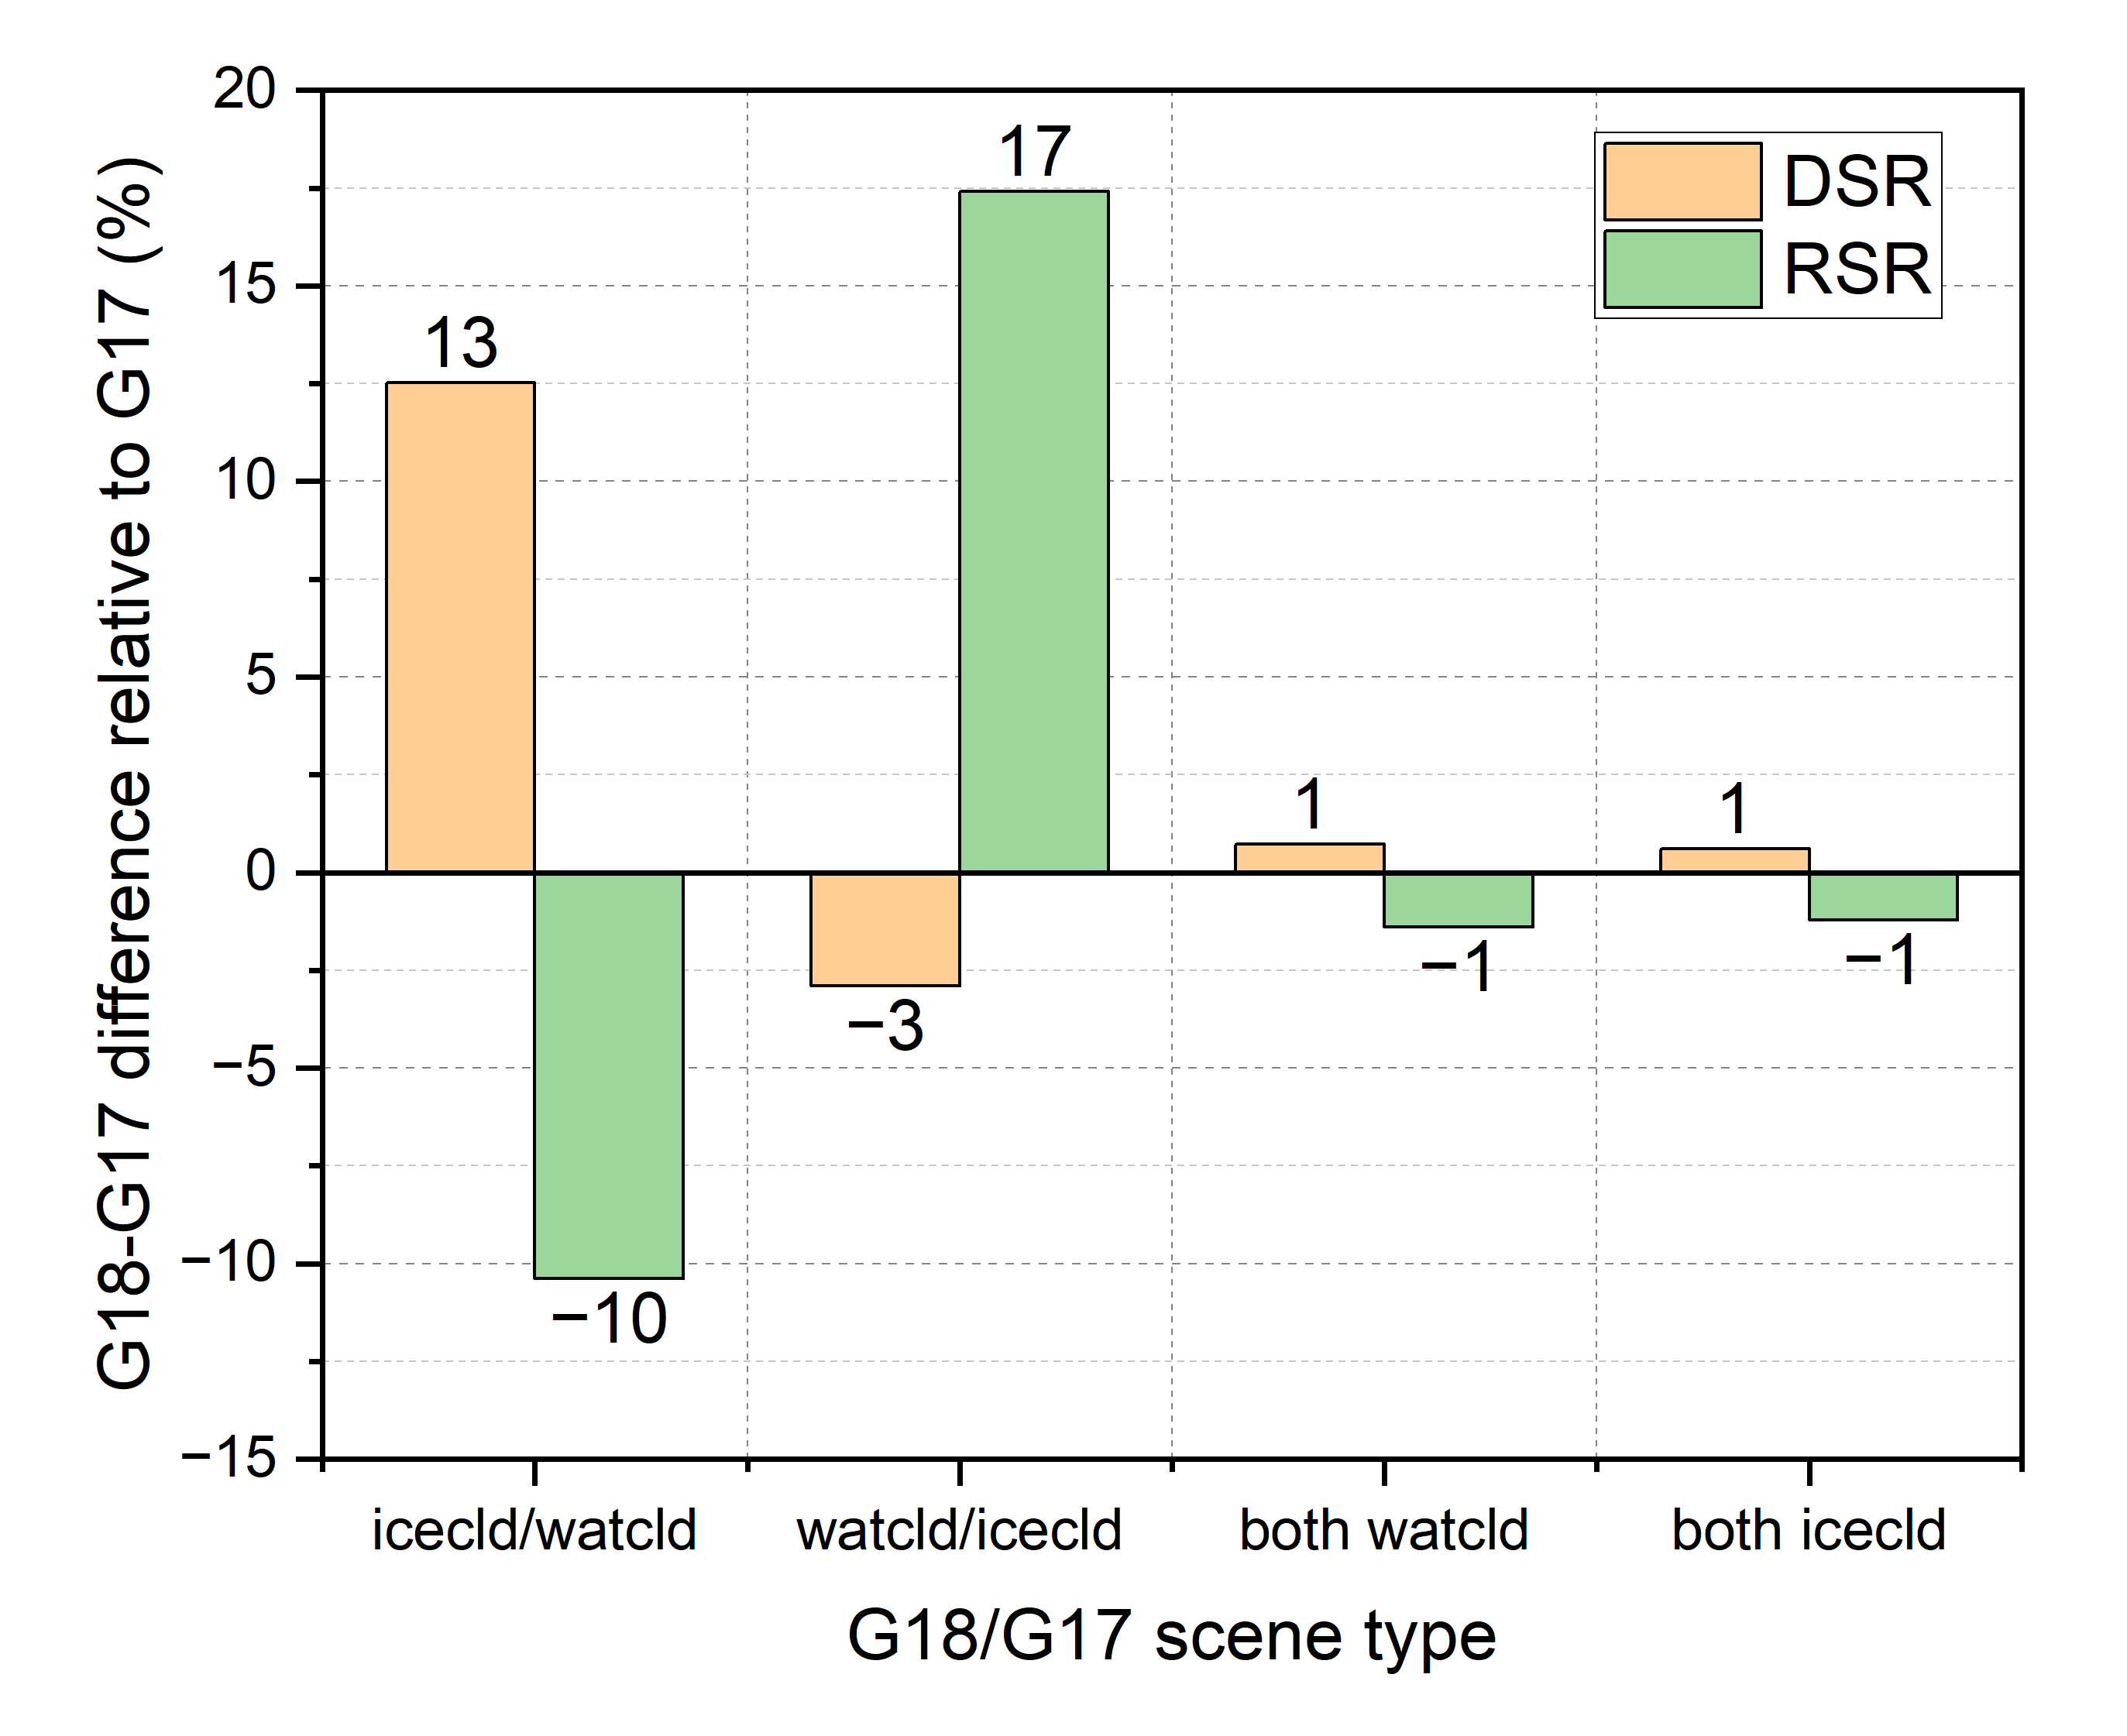
CONUS G18-G17 DSR and RSR differences vs. cloudy types
21 UTC on 8/10/2022
For single grid cells at a given time, the G18-G17 flux difference can be large:
  E.g., 50 Wm⁻² in DSR, representing 13% of G17 DSR, when G18 uses ice cloud in the retrieval instead of water cloud used in the G17 retrieval, compared to the case when G18 and G17 agrees on the cloud type, which results in differences of 3-4 Wm⁻² representing 1% of the G17 values.

Slide 41
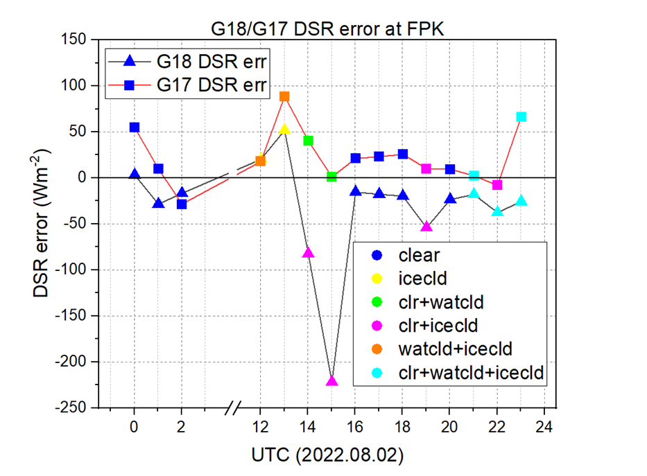
Impact on DSR at different time of day
DSR error and scene type in G18 and G17 at Fort Peck, Montana on 8/2/2022
G18 and G17 indicate different cloud phases in mixed scenes at 12 – 15 and 22 UTC.
The largest DSR difference (>200 Wm⁻²) is at 15 UTC when G18 IP indicates clear + ice cloud while G17 IP indicates clear + water cloud.
However, scene type difference does not always result in a large error. Conversely, having the same G18 and G17 scene types can also lead to relatively large difference in G18 and G17 errors.
Overlap of points
G18: icecld
G17: watcld+icecld

Slide 42
Summary of cloud phase impact
Cloud-phase errors can result in occasional large differences in instantaneous fluxes at single grid cells.
However, many times flux differences due to cloud-phase difference are comparable to those with identical cloud phases. Cloud phase is only one of the inputs that determine the fluxes.
Frequency and large number of mixed scene types reduce the impact on SRB of cloud phase error present at cloud edges.
In spite of phase differences, evaluation of fluxes with reference data has demonstrated that accuracy and precision of G18 RSR and DSR are comparable to those from G17 (G16).

Slide 43
Provisional Maturity Assessment
GOES-18 Shortwave Radiation Budget L2 Product Provisional PS-PVR

Slide 44
Provisional Validation
Preparation Activities | Assessment
Validation activities are ongoing and the general research community is now encouraged to participate. | Validation activities are ongoing. The general research community has been participating and providing feedback.
Severe algorithm anomalies are identified and under analysis. Solutions to anomalies are in development and testing. | Known operational anomalies have been identified. Four MESO ADRs remain on-hold; two ADRs are open (incorrect source of TPW in mixed scene; bad initialization of PQIs and missing IP flag_meaning in PQI3); none of them impacts accuracy/precision, and expected to be taken care of in the Enterprise algorithm.
Incremental product improvements may still be occurring. | Incremental product improvements are expected.

Slide 45
Provisional Validation
End State | Assessment
Product performance has been demonstrated through analysis of a small number of independent measurements obtained from select locations, periods, and associated ground truth or field campaign efforts. | This has been demonstrated using CERES, SURFRAD and SOLRAD as truth and independent statellite retrivals from GOES-17 (and GOES-16).
Product analysis is sufficient to communicate product performance to users relative to expectations (Performance Baseline). | This has been communicated in PS-PVR.
Documentation of product performance exists that includes recommended remediation strategies for all anomalies and weaknesses. Any algorithm changes associated with severe anomalies have been documented, implemented, tested, and shared with the user community. | These are documented in this PS-PVR presentation and will be documented in a separate ReadMe file.
Product is ready for operational use and for use in comprehensive cal/val activities and product optimization. | We concur.

Slide 46
Path to full Validation Maturity
GOES-18 Shortwave Radiation Budget L2 Product Provisional PS-PVR

Slide 47
Issues and Status
ADRs Potentially Needing Resolution for Full VAL
ADR | Title | Status | Build
617 | ClearCompAlb is incorrect in MESO product. Time series has only a single value (one day). | On hold | --
864 | G18 MESO1/2 is located incorrectly
914 | MESO DSR is filled with _FillValue during local daytime
933 | G18 DSRM2 if filled with _FillValue
994 | TPW source in PQI1 was set incorrectly for some mixed scene grids | On hold | --
743 | Missing flag_meanings attribute for PQI3. | On hold | --
 | PQIs are not initialized with _FillValue. | On hold | --
408 393 | Remove unnecessary lat/lon re-projection from Radiation | On hold | --
N/A | Incorrect statistics in M4 CONUS metadata | On hold | --
ADRs in green are for MESO; the MESO product will be decommissioned once the enterprise algorithm becomes operational and in which case these ADRs will not need to be addressed.
ADRs in black are revisited with enterprise implementation in ground system.

Slide 48
Issues and Status
Other Actions Needed for Full VAL
Action | Title | Desired Implementation Date into OE
N/A | L2 SRB algorithm - further update for G18 ABI of the narrow-to-broadband (NTB) albedo conversion | ≧6 month prior to PS-PVR FULL
The action applies to the Enterprise algorithm that is slated to replace the Baseline algorithm in January 2023 and uses empirical narrow-to-broadband conversion.
  A simulation-based narrow-to-broadband conversion, similar to the ones developed for the G16/17 Baseline versions, will also be developed for G18 to serve as a backup in case the empirical ones have deficiencies for particular scene types.

Slide 49
Path to Full Validation - PLPTs
PLPT ID | Descriptive Title
ABI-FD_DSR06 ABI-FD_RSR06 ABI-FD_PAR06^ | Assess precision and accuracy of FD product for an extended period that includes seasonally representative number of independent measurements
ABI-CONUS_DSR07* ABI-CONUS_RSR07* | Assess precision and accuracy of CONUS product for an extended period that includes seasonally representative number of independent measurements
ABI-MESO_DSR08* | Assess precision and accuracy of MESO product for an extended period that includes seasonally representative number of independent measurements
^ Once the Enterprise version of the algorithm becomes operational, the PAR product will be added and
* the MESO and CONUS products will be decommissioned.
AWG SRB Team will conduct these tests to further evaluate the L2 SRB product quality.
Full test plans and procedures are given in the Geostationary Operational Environmental Satellite (GOES)-R Series ABI L2+ Surface Downward Shortwave Radiation and Top-of-Atmosphere Reflected Shortwave Radiation (DSR-RSR) Beta, Provisional and Full Validation Readiness, Implementation and Management Plan (RIMP) (v2.0; 410-R-RIMP-0327, Oct 6,2021).

Slide 50
Path to Full Validation – Risks
Risk Name | Description | Impact | Mitigation and Schedule
Update NTB coefficients | as discussed; Priority 1 | Moderate | Extend G18 record used for developing empirical NTB; TBD
NTB: narrowband-to-broadband
Little Impact
Moderate Impact
Big Impact

Slide 51
Summary & Recommendations
GOES-18 Shortwave Radiation Budget L2 Product Provisional PS-PVR

Slide 52
Summary
Overall, the FD and CONUS DSR and RSR products are ready for operational and scientific use
  FD and CONUS RSR and DSR products from GOES West location are useable starting 09/28/2022 (clear sky mask product reached provisional).
    SRB retrievals are impacted by cloud phase product that is not yet provisional. The impact magnitude varies; does not lead to significant G18-G17 differences.
  MESO products were not evaluated due to incorrect mapping or having no retrievals.
  In general, good quality retrievals are recommended for quantitative applications due to their better overall performance.
Measured RSR and DSR performance against reference data
  Accuracy and precision specs are met in all domains and ranges of DSR.
  RSR accuracy specs are met except in high range over FD.
  RSR precision specs are met except in high range over FD and CONUS.
  Updates will be needed for the narrow-to-broadband (NTB) transformation to further improve performance. (Requires collection of more G18 ABI and CERES data.)

Slide 53
Recommendation
AWG SRB Team believes that the GOES-18 L2 RSR and DSR Full Disk and CONUS products have reached Provisional Maturity, as defined by the GOES-R Program.
GOES-18 MESO DSR product has same mapping issue as GOES-16 and GOES-17, and will be described as a known issue in the README document.

Slide 54
Supplements
Supplement A: Visual Inspection of MESO product
Supplement B: Visual Inspection of M4 product
Supplement C: Comparison with GOES-16
Supplement D: Empirical NTB
Supplement E: Impact of G18 ABI Band 2 calibration adjustment
GOES-18 Shortwave Radiation Budget L2 Product Provisional PS-PVR

Slide 55
Supplement A
Visual Inspection of meso product
GOES-18 Shortwave Radiation Budget L2 Product Provisional PS-PVR

Slide 56
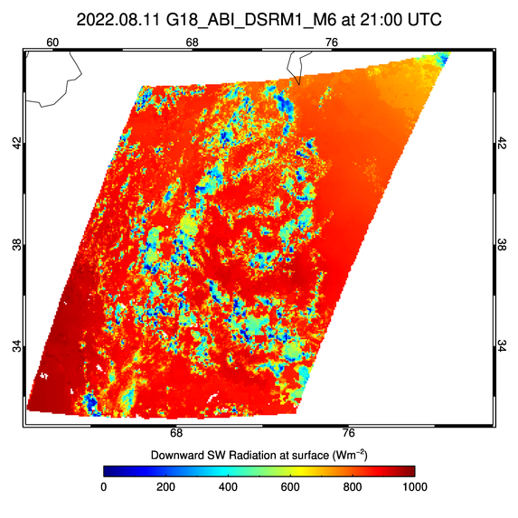
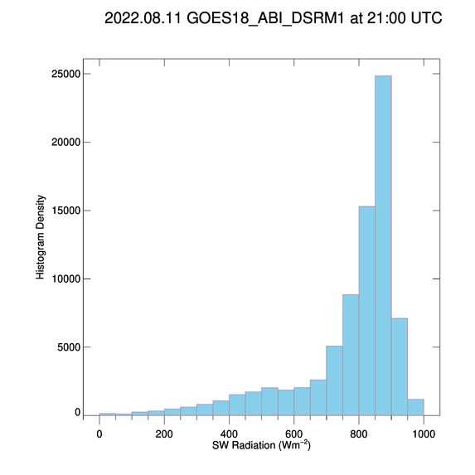
PLPT Task ABI-MESO_DSR03
M6 MESO-1 DSR product is within range although located out side of area “seen” by GOES-18
  Good DQF retrievals were used

Slide 57
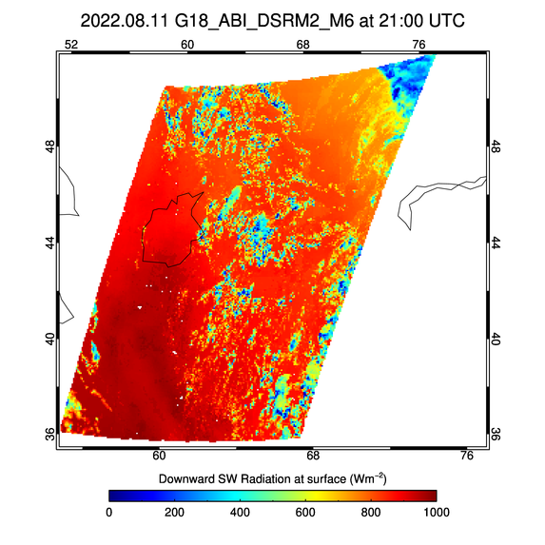
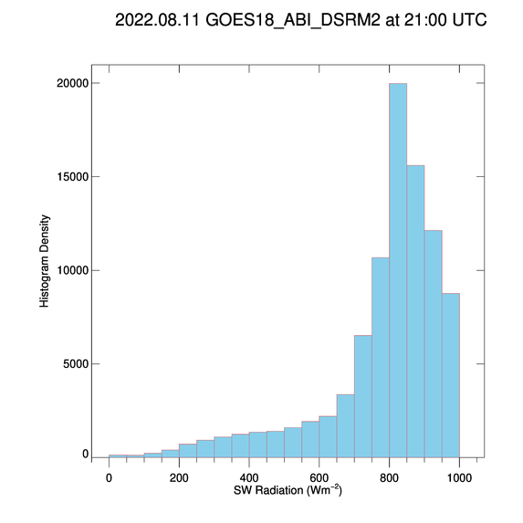
PLPT Task ABI-MESO_DSR03
M6 MESO-2 DSR product is within range although located out side of area “seen” by GOES-18
  Good DQF retrievals were used

Slide 58
Supplement B
Visual Inspection of M4 product
GOES-18 Shortwave Radiation Budget L2 Product Provisional PS-PVR

Slide 59
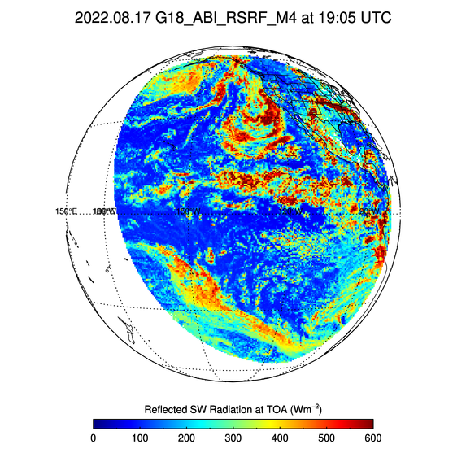
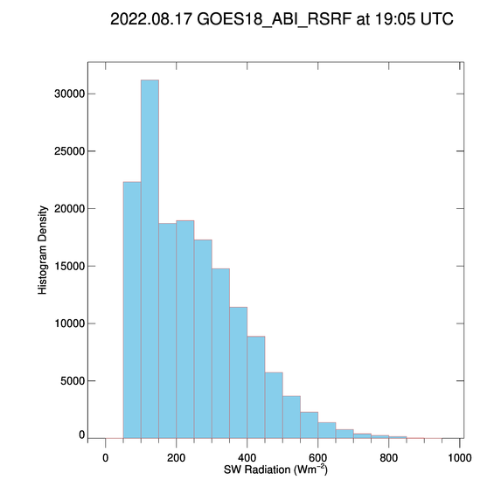
PLPT Task ABI-FD_RSR04
M4 FD RSR product is within range
  Good DQF retrievals were used

Slide 60
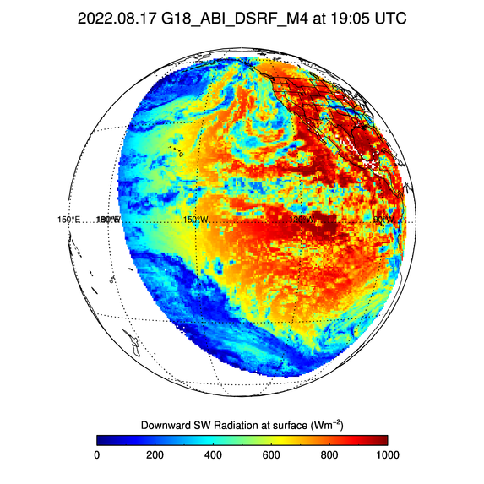
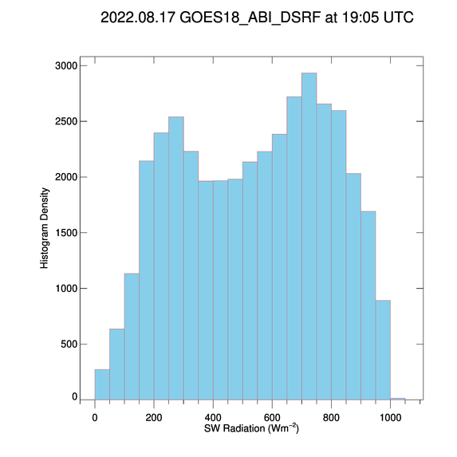
PLPT Task ABI-FD_DSR04
M4 FD DSR product is within range
  Good DQF retrievals were used

Slide 61
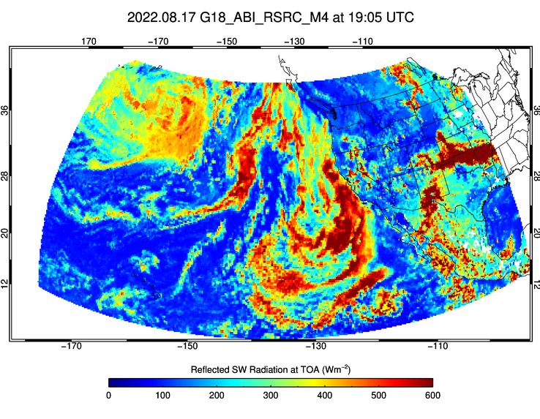
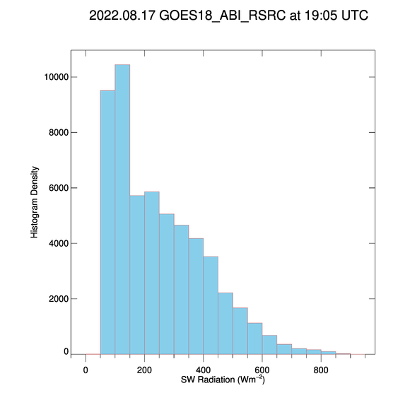
PLPT Task ABI-CONUS_RSR05
M4 CONUS RSR product is within range
  Good DQF retrievals were used

Slide 62
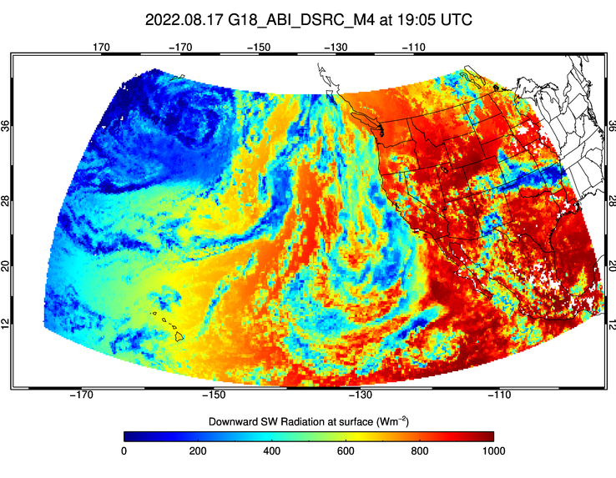
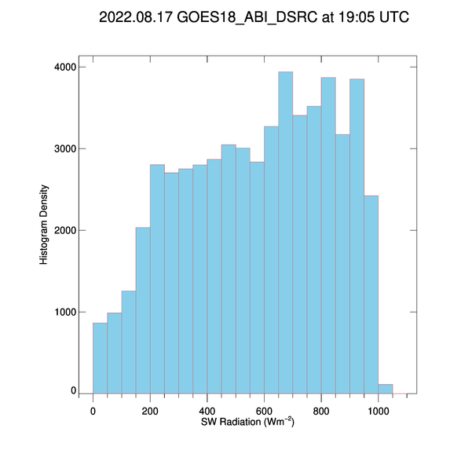
PLPT Task ABI-CONUS_DSR05
M4 CONUS DSR product is within range
  Good DQF retrievals were used

Slide 63
Visual Comparison Summary
GOES-18 RSR and DSR products are displayed and checked on a daily basis.
All FD and CONUS M6 and M4 products are within required measurement range.
  MESO products are located outside of area “seen” by GOES-18
Assessment: PASSED
  Range results indicate product is sufficiently reasonable to begin accuracy assessment.

Slide 64
Supplement C
Comparison with GOES-16
GOES-18 Shortwave Radiation Budget L2 Product Provisional PS-PVR

Slide 65
Data used
RSR and DSR FD products in G18-G16 overlap area on Aug 11, 2022.
Comparison with reference data over the same stations for period Jul 28 – Sept 30, 2022.

Slide 66
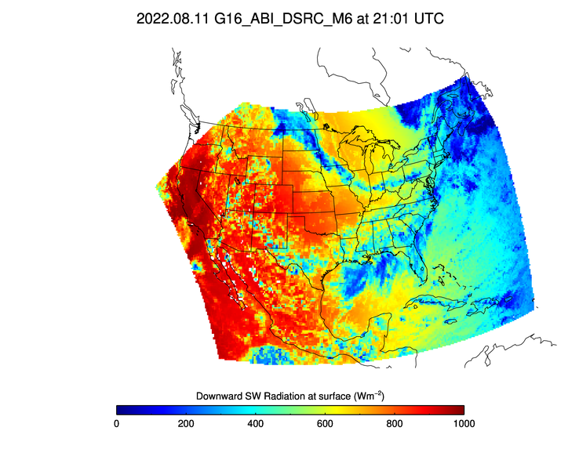
G18/G16 CONUS Flux Comparison: 21 UTC on 8/11/22
G18 DSRC (L) and G16 DSRC (R)
G18 and G16 CONUS domains cover mostly different areas, but in the common area the products are visually similar.

Slide 67
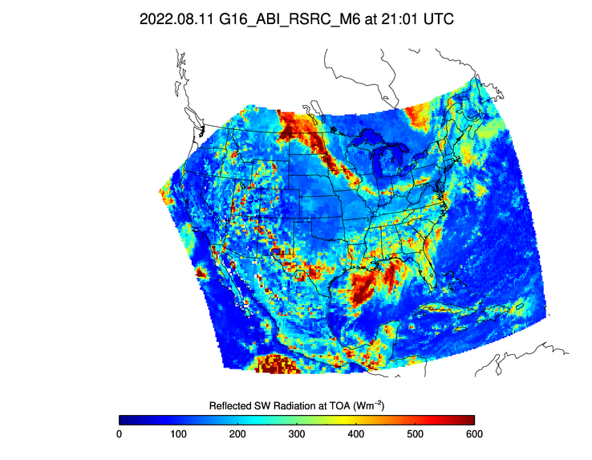
G18/G16 CONUS Flux Comparison: 21 UTC on 8/11/22
G18 RSRC (L) and G16 RSRC (R)
G18 and G16 CONUS domains cover mostly different areas, but in the common area the products are visually similar.

Slide 68
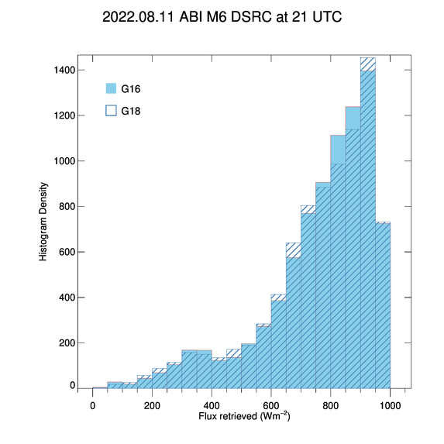



Flux difference in the overlap area at 21 UTC on 8/11/22
PLPT tests ABI-CONUS DSR02 and RSR02
Distributions of CONUS G18 DSR and RSR are similar to those from G16.
Largest number of G18 – G16 differences are clustered around the zero value.
The mean G18 - G16 DSR and RSR differences are -4 and 8 Wm⁻², respectively. Somewhat larger than those from G18-G17.

Slide 69

G18/G16 FD Flux Comparison: 21 UTC on 8/11/22
G18 DSRF (L) and G16 DSRF (R)
G18 and G16 DSRs in the common area are visually similar.

Slide 70

G18/G16 FD Flux Comparison: 21 UTC on 8/11/22
G18 RSRF (L) and G16 RSRF (R)
G18 and G16 RSRs in the common area are visually similar.

Slide 71




Flux difference in overlap area at 21 UTC on 8/11/22
PLPT tests ABI-FD DSR01 and RSR01
Distributions of FD G18 DSR and RSR are largely similar to those from G16, but less similar than from G17, slightly shifted to the left and right.
Largest number of G18 – G16 differences are clustered around the zero value but with a wider tail.
The mean G18 - G16 DSR and RSR differences are -6 and 6 Wm⁻², respectively.

Slide 72


CONUS DSR comparison over same stations
DSRC from G18 and G16 for 7/28 – 9/30, 2022 compared with ground measurements.
  G18 accuracy and precision are comparable to (or slightly better than) G16 accuracy and precision.

Slide 73
Supplement D
Empirical NTB
GOES-18 Shortwave Radiation Budget L2 Product Provisional PS-PVR

Slide 74
Data Set and Strategy
Ran Enterprise SRB algorithm in G18 FD with empirical NTB offline at 2 km.
Compared baseline RSR (simulation-based NTB, 25 km) and offline EPS RSR (empirical NTB, 2 km) with CERES/Terra observation on 09/29/22.
Compared RSR retrieval error of G18 baseline and offline EPS SRB products.

Slide 75


G18 baseline and (offline) EPS RSRF: 21 UTC on 9/29/22
Different narrow-to-broadband (NTB) conversion is used; simulation-based NTB in baseline (L) and empirical NTB in offline EPS (R).
Apart from the difference in spatial resolution (25km vs. 2km), RSR fields are visually similar.

Slide 76
G18 RSRF comparison with CERES/Terra on 9/29/22
Comparison of G18 baseline 25-km RSRF using simulation-based NTB (L) and 2-km EPS RSRF using empirical NTB (R).
 | Baseline |  |  | Offline EPS
Range | A | P | N | A | P | N
CERES < 200 | 33 (110) | 60 (100) | 235,923 | 10 (110) | 59 (100) | 9,951,952
[200, 500] | 7 (65) | 71 (130) | 227,667 | -19 (65) | 86 (130) | 7,033,596
CERES > 500 | -108 (85) | 140 (100) | 24,074 | -83 (85) | 87 (100) | 1,137,419
All | 14 | 77 | 487,664 | -7 | 76 | 18,122,967
Empirical NTB helps meeting the requirements at the high-end RSR.

Slide 77
Supplement E
Impact of G18 ABI Band 2 calibration adjustment
GOES-18 Shortwave Radiation Budget L2 Product Provisional PS-PVR

Slide 78

Data Set and Strategy
Compared time series of G18 and G17 DSR errors for 7/1/22 – 8/31/22 that includes observations before and after the calibration update.
There is no detectable impact of B02 bias adjustment on SRB products.
G18 Accuracy (A) and Precision (P) are similar before and after G18 ABI B02 calibration adjustment; they are comparable to G17 A and P for each time period. A and P for the entire period are 15 and 85 Wm⁻² for both G17 and G18 products.

